Slide 1
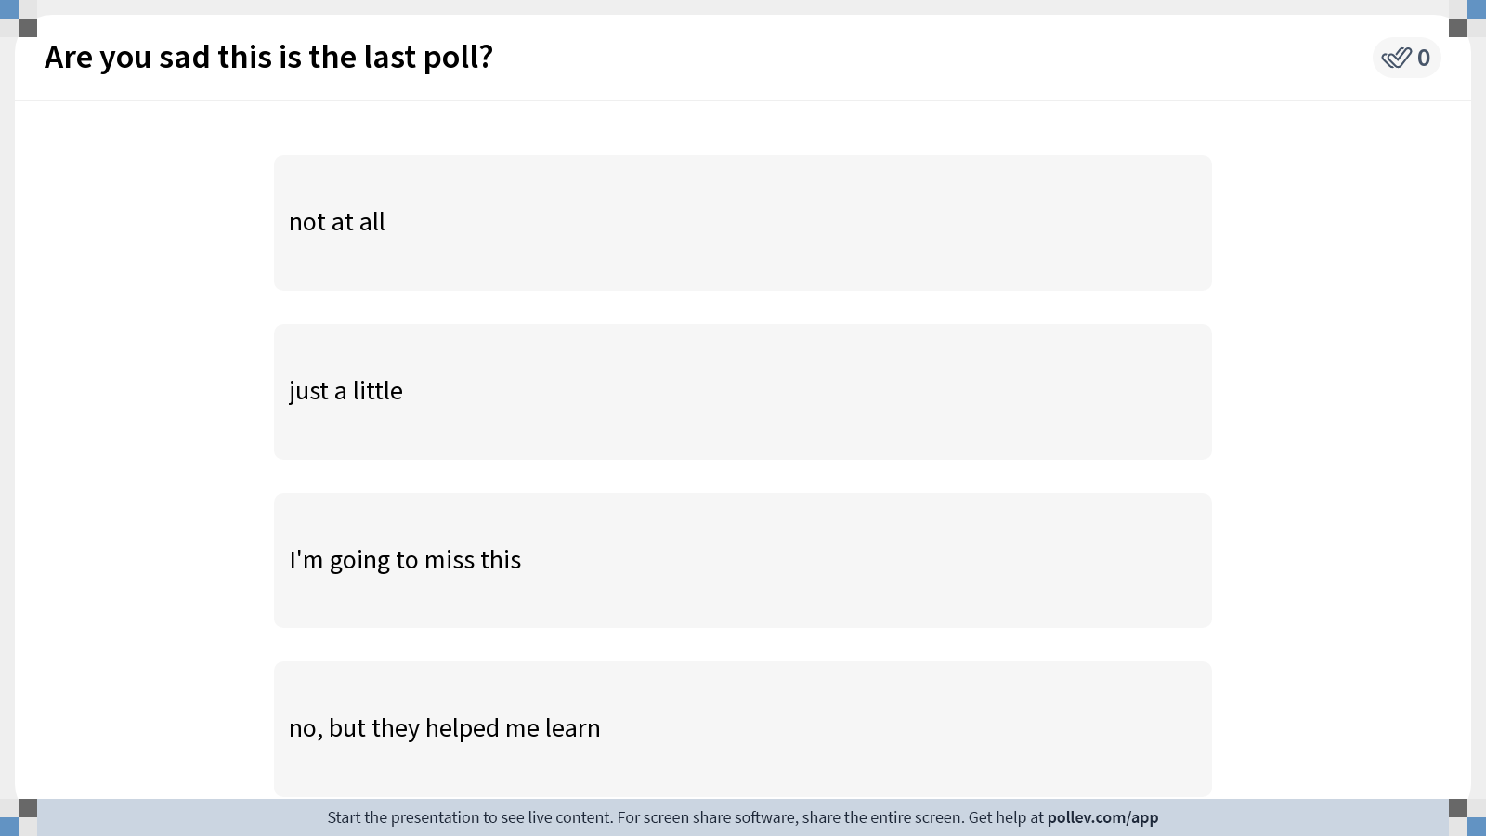
Notes:
Do not modify the notes in this section to avoid tampering with the Poll Everywhere activity. More info at polleverywhere.com/support Are you sad this is the last poll?
https://www.polleverywhere.com/multiple_choice_polls/rdrJqpvmpwX5lVKaSZHgI?display_state=instructions&activity_state=opened&state=opened&flow=Engagement&onscreen=persist

Slide 2
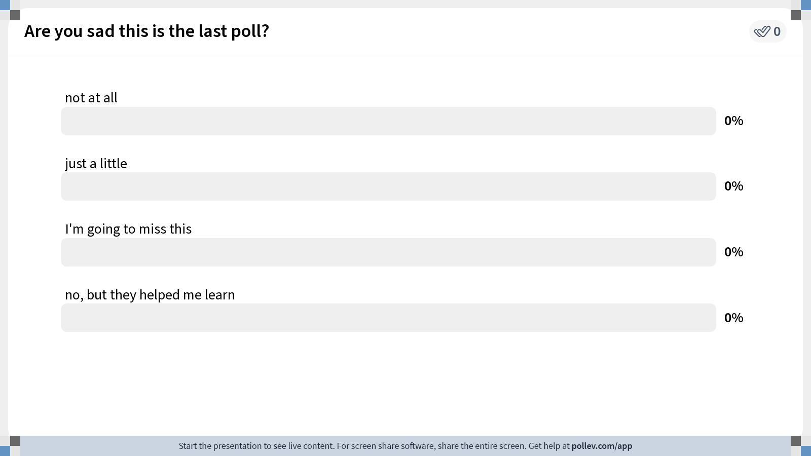
Notes:
Do not modify the notes in this section to avoid tampering with the Poll Everywhere activity. More info at polleverywhere.com/support Are you sad this is the last poll?
https://www.polleverywhere.com/multiple_choice_polls/rdrJqpvmpwX5lVKaSZHgI?display_state=chart&activity_state=opened&state=opened&flow=Engagement&onscreen=persist

Slide 3
Notes:
Do not modify the notes in this section to avoid tampering with the Poll Everywhere activity. More info at polleverywhere.com/support Are you sad this is the last poll?
https://www.polleverywhere.com/multiple_choice_polls/rdrJqpvmpwX5lVKaSZHgI?display_state=chart&activity_state=closed&state=closed&flow=Engagement&onscreen=persist

Slide 4
Fundamentals of Ecology
Week 9, Ecology Lecture 8
Cara Brook
February 29, 2024

Slide 5
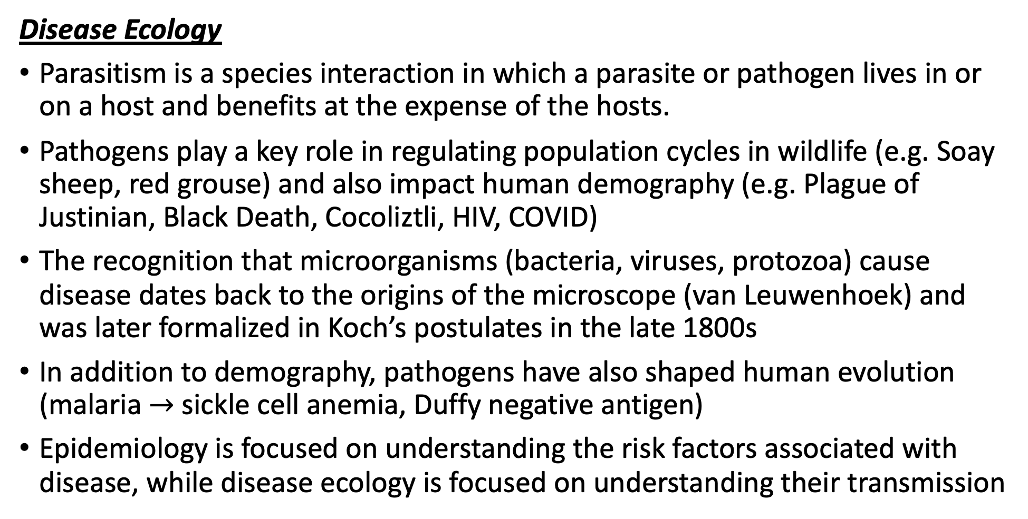
Let’s recap a bit!
Disease Ecology
Parasitism is a species interaction in which a parasite or pathogen lives in or on a host and benefits at the expense of the hosts.
Pathogens play a key role in regulating population cycles in wildlife (e.g. Soay sheep, red grouse) and also impact human demography (e.g. Plague of Justinian, Black Death, Cocoliztli, HIV, COVID)
The recognition that microorganisms (bacteria, viruses, protozoa) cause disease dates back to the origins of the microscope (van Leuwenhoek) and was later formalized in Koch’s postulates in the late 1800s
In addition to demography, pathogens have also shaped human evolution (malaria $→$ sickle cell anemia, Duffy negative antigen)
Epidemiology is focused on understanding the risk factors associated with disease, while disease ecology is focused on understanding their transmission

Slide 6
Let’s recap a bit!
Disease Ecology
The transmission-virulence tradeoff offers an explanation for why pathogens cause disease: virulence is a by-product of the mechanisms (e.g. high growth rates) that help a pathogen transmit to new hosts.
Pathogens evolve to maximize R₀. Because increasing transmission often increases virulence, balancing these tradeoffs results in the evolution of optimal virulence.
We discussed a few examples of the transmission-virulence tradeoff: myxoma virus in rabbits, and a protozoan parasite of Monarch butterflies.
We also discussed conditions in which this tradeoff is hard to observe or not supported, such as in cases of zoonotic virulence (where a pathogen optimizes on a non-target host), in cases where most disease is as immunopathology, or in cases where transmission and virulence are decoupled.
We learned that virulence tends to be reduced when transmission is more local.
And we learned that imperfect vaccines, especially those targeting pathogen growth rates, can also result in the evolution of higher virulence pathogens.
Disease Ecology
Parasitism is a species interaction in which a parasite or pathogen lives in or on a host and benefits at the expense of the hosts.
Pathogens play a key role in regulating population cycles in wildlife (e.g. Soay sheep, red grouse) and also impact human demography (e.g. Plague of Justinian, Black Death, Cocoliztli, HIV, COVID)
The recognition that microorganisms (bacteria, viruses, protozoa) cause disease dates back to the origins of the microscope (van Leuwenhoek) and was later formalized in Koch’s postulates in the late 1800s
In addition to demography, pathogens have also shaped human evolution (malaria $→$ sickle cell anemia, Duffy negative antigen)
Epidemiology is focused on understanding the risk factors associated with disease, while disease ecology is focused on understanding their transmission

Slide 7
Let’s recap a bit!
Disease Ecology
The transmission-virulence tradeoff offers an explanation for why pathogens cause disease: virulence is a by-product of the mechanisms (e.g. high growth rates) that help a pathogen transmit to new hosts.
Pathogens evolve to maximize R₀. Because increasing transmission often increases virulence, balancing these tradeoffs results in the evolution of optimal virulence.
We discussed a few examples of the transmission-virulence tradeoff: myxoma virus in rabbits, and a protozoan parasite of Monarch butterflies.
We also discussed conditions in which this tradeoff is hard to observe or not supported, such as in cases of zoonotic virulence (where a pathogen optimizes on a non-target host), in cases where most disease is as immunopathology, or in cases where transmission and virulence are decoupled.
We learned that virulence tends to be reduced when transmission is more local.
And we learned that imperfect vaccines, especially those targeting pathogen growth rates, can also result in the evolution of higher virulence pathogens.
Disease Ecology
Parasitism is a species interaction in which a parasite or pathogen lives in or on a host and benefits at the expense of the hosts.
Pathogens play a key role in regulating population cycles in wildlife (e.g. Soay sheep, red grouse) and also impact human demography (e.g. Plague of Justinian, Black Death, Cocoliztli, HIV, COVID)
The recognition that microorganisms (bacteria, viruses, protozoa) cause disease dates back to the origins of the microscope (van Leuwenhoek) and was later formalized in Koch’s postulates in the late 1800s
In addition to demography, pathogens have also shaped human evolution (malaria $→$ sickle cell anemia, Duffy negative antigen)
Epidemiology is focused on understanding the risk factors associated with disease, while disease ecology is focused on understanding their transmission

Slide 8
Let’s recap a bit!
Disease Ecology
The transmission-virulence tradeoff offers an explanation for why pathogens cause disease: virulence is a by-product of the mechanisms (e.g. high growth rates) that help a pathogen transmit to new hosts.
Pathogens evolve to maximize R₀. Because increasing transmission often increases virulence, balancing these tradeoffs results in the evolution of optimal virulence.
We discussed a few examples of the transmission-virulence tradeoff: myxoma virus in rabbits, and a protozoan parasite of Monarch butterflies.
We also discussed conditions in which this tradeoff is hard to observe or not supported, such as in cases of zoonotic virulence (where a pathogen optimizes on a non-target host), in cases where most disease is as immunopathology, or in cases where transmission and virulence are decoupled.
We learned that virulence tends to be reduced when transmission is more local.
And we learned that imperfect vaccines, especially those targeting pathogen growth rates, can also result in the evolution of higher virulence pathogens.
Disease Ecology
Parasitism is a species interaction in which a parasite or pathogen lives in or on a host and benefits at the expense of the hosts.
Pathogens play a key role in regulating population cycles in wildlife (e.g. Soay sheep, red grouse) and also impact human demography (e.g. Plague of Justinian, Black Death, Cocoliztli, HIV, COVID)
The recognition that microorganisms (bacteria, viruses, protozoa) cause disease dates back to the origins of the microscope (van Leuwenhoek) and was later formalized in Koch’s postulates in the late 1800s
In addition to demography, pathogens have also shaped human evolution (malaria $→$ sickle cell anemia, Duffy negative antigen)
Epidemiology is focused on understanding the risk factors associated with disease, while disease ecology is focused on understanding their transmission

Slide 9
Let’s recap a bit!
Disease Ecology
The transmission-virulence tradeoff offers an explanation for why pathogens cause disease: virulence is a by-product of the mechanisms (e.g. high growth rates) that help a pathogen transmit to new hosts.
Pathogens evolve to maximize R₀. Because increasing transmission often increases virulence, balancing these tradeoffs results in the evolution of optimal virulence.
We discussed a few examples of the transmission-virulence tradeoff: myxoma virus in rabbits, and a protozoan parasite of Monarch butterflies.
We also discussed conditions in which this tradeoff is hard to observe or not supported, such as in cases of zoonotic virulence (where a pathogen optimizes on a non-target host), in cases where most disease is as immunopathology, or in cases where transmission and virulence are decoupled.
We learned that virulence tends to be reduced when transmission is more local.
And we learned that imperfect vaccines, especially those targeting pathogen growth rates, can also result in the evolution of higher virulence pathogens.
Disease Ecology
Parasitism is a species interaction in which a parasite or pathogen lives in or on a host and benefits at the expense of the hosts.
Pathogens play a key role in regulating population cycles in wildlife (e.g. Soay sheep, red grouse) and also impact human demography (e.g. Plague of Justinian, Black Death, Cocoliztli, HIV, COVID)
The recognition that microorganisms (bacteria, viruses, protozoa) cause disease dates back to the origins of the microscope (van Leuwenhoek) and was later formalized in Koch’s postulates in the late 1800s
In addition to demography, pathogens have also shaped human evolution (malaria $→$ sickle cell anemia, Duffy negative antigen)
Epidemiology is focused on understanding the risk factors associated with disease, while disease ecology is focused on understanding their transmission

Slide 10
Let’s recap a bit!
Disease Ecology
The transmission-virulence tradeoff offers an explanation for why pathogens cause disease: virulence is a by-product of the mechanisms (e.g. high growth rates) that help a pathogen transmit to new hosts.
Pathogens evolve to maximize R₀. Because increasing transmission often increases virulence, balancing these tradeoffs results in the evolution of optimal virulence.
We discussed a few examples of the transmission-virulence tradeoff: myxoma virus in rabbits, and a protozoan parasite of Monarch butterflies.
We also discussed conditions in which this tradeoff is hard to observe or not supported, such as in cases of zoonotic virulence (where a pathogen optimizes on a non-target host), in cases where most disease is as immunopathology, or in cases where transmission and virulence are decoupled.
We learned that virulence tends to be reduced when transmission is more local.
And we learned that imperfect vaccines, especially those targeting pathogen growth rates, can also result in the evolution of higher virulence pathogens.
Disease Ecology
Parasitism is a species interaction in which a parasite or pathogen lives in or on a host and benefits at the expense of the hosts.
Pathogens play a key role in regulating population cycles in wildlife (e.g. Soay sheep, red grouse) and also impact human demography (e.g. Plague of Justinian, Black Death, Cocoliztli, HIV, COVID)
The recognition that microorganisms (bacteria, viruses, protozoa) cause disease dates back to the origins of the microscope (van Leuwenhoek) and was later formalized in Koch’s postulates in the late 1800s
In addition to demography, pathogens have also shaped human evolution (malaria $→$ sickle cell anemia, Duffy negative antigen)
Epidemiology is focused on understanding the risk factors associated with disease, while disease ecology is focused on understanding their transmission

Slide 11
Let’s recap a bit!
Disease Ecology
The transmission-virulence tradeoff offers an explanation for why pathogens cause disease: virulence is a by-product of the mechanisms (e.g. high growth rates) that help a pathogen transmit to new hosts.
Pathogens evolve to maximize R₀. Because increasing transmission often increases virulence, balancing these tradeoffs results in the evolution of optimal virulence.
We discussed a few examples of the transmission-virulence tradeoff: myxoma virus in rabbits, and a protozoan parasite of Monarch butterflies.
We also discussed conditions in which this tradeoff is hard to observe or not supported, such as in cases of zoonotic virulence (where a pathogen optimizes on a non-target host), in cases where most disease is as immunopathology, or in cases where transmission and virulence are decoupled.
We learned that virulence tends to be reduced when transmission is more local.
And we learned that imperfect vaccines, especially those targeting pathogen growth rates, can also result in the evolution of higher virulence pathogens.
Disease Ecology
Parasitism is a species interaction in which a parasite or pathogen lives in or on a host and benefits at the expense of the hosts.
Pathogens play a key role in regulating population cycles in wildlife (e.g. Soay sheep, red grouse) and also impact human demography (e.g. Plague of Justinian, Black Death, Cocoliztli, HIV, COVID)
The recognition that microorganisms (bacteria, viruses, protozoa) cause disease dates back to the origins of the microscope (van Leuwenhoek) and was later formalized in Koch’s postulates in the late 1800s
In addition to demography, pathogens have also shaped human evolution (malaria $→$ sickle cell anemia, Duffy negative antigen)
Epidemiology is focused on understanding the risk factors associated with disease, while disease ecology is focused on understanding their transmission

Slide 12
Let’s recap a bit!
Disease Ecology
The “dilution effect” offers a hypothesis about the disease-buffering services of biodiversity, which is often supported by the case study of Lyme disease.
Amplification vs. dilution effects are determined by biodiversity impacts on vector abundance, as well as the ratio of competent to non-competent hosts.
Community Ecology
Succession is the process of change in the species structure of ecological communities with time, from pioneer species dominated by r-selected species to climax communities dominated by K-selected species.
Primary succession builds from bare substrate, while secondary succession builds on existing soil and nutrients.
The intermediate disturbance hypothesis suggests that the highest biodiversity should occur in ecosystems with intermediate levels of disturbance where r- and K-selected species coexist.

Slide 13
Let’s recap a bit!
Disease Ecology
The “dilution effect” offers a hypothesis about the disease-buffering services of biodiversity, which is often supported by the case study of Lyme disease.
Amplification vs. dilution effects are determined by biodiversity impacts on vector abundance, as well as the ratio of competent to non-competent hosts.
Community Ecology
Succession is the process of change in the species structure of ecological communities with time, from pioneer species dominated by r-selected species to climax communities dominated by K-selected species.
Primary succession builds from bare substrate, while secondary succession builds on existing soil and nutrients.
The intermediate disturbance hypothesis suggests that the highest biodiversity should occur in ecosystems with intermediate levels of disturbance where r- and K-selected species coexist.

Slide 14
Let’s recap a bit!
Disease Ecology
The “dilution effect” offers a hypothesis about the disease-buffering services of biodiversity, which is often supported by the case study of Lyme disease.
Amplification vs. dilution effects are determined by biodiversity impacts on vector abundance, as well as the ratio of competent to non-competent hosts.
Community Ecology
Succession is the process of change in the species structure of ecological communities with time, from pioneer species dominated by r-selected species to climax communities dominated by K-selected species.
Primary succession builds from bare substrate, while secondary succession builds on existing soil and nutrients.
The intermediate disturbance hypothesis suggests that the highest biodiversity should occur in ecosystems with intermediate levels of disturbance where r- and K-selected species coexist.

Slide 15
Let’s recap a bit!
Disease Ecology
The “dilution effect” offers a hypothesis about the disease-buffering services of biodiversity, which is often supported by the case study of Lyme disease.
Amplification vs. dilution effects are determined by biodiversity impacts on vector abundance, as well as the ratio of competent to non-competent hosts.
Community Ecology
Succession is the process of change in the species structure of ecological communities with time, from pioneer species dominated by r-selected species to climax communities dominated by K-selected species.
Primary succession builds from bare substrate, while secondary succession builds on existing soil and nutrients.
The intermediate disturbance hypothesis suggests that the highest biodiversity should occur in ecosystems with intermediate levels of disturbance where r- and K-selected species coexist.

Slide 16
Let’s recap a bit!
Disease Ecology
The “dilution effect” offers a hypothesis about the disease-buffering services of biodiversity, which is often supported by the case study of Lyme disease.
Amplification vs. dilution effects are determined by biodiversity impacts on vector abundance, as well as the ratio of competent to non-competent hosts.
Community Ecology
Succession is the process of change in the species structure of ecological communities with time, from pioneer species dominated by r-selected species to climax communities dominated by K-selected species.
Primary succession builds from bare substrate, while secondary succession builds on existing soil and nutrients.
The intermediate disturbance hypothesis suggests that the highest biodiversity should occur in ecosystems with intermediate levels of disturbance where r- and K-selected species coexist.

Slide 17
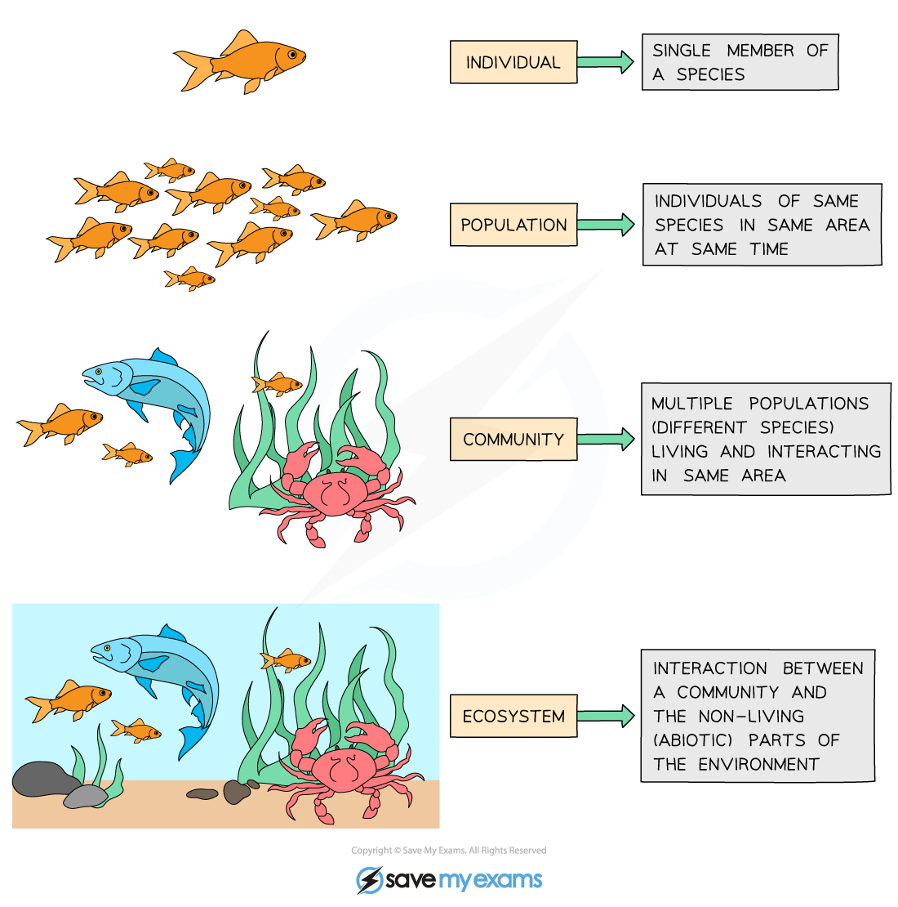
Ecology is the study of the interactions of organisms with each other and their environment.
individual
population
metapopulation
community
ecosystem
Notes:
We explore ecology – using models – across scales

Slide 18
individual
Individual: metabolism, behavior, life history.
interactions of an individual with the environment
population
metapopulation
community
ecosystem
Notes:
At the bottom, there is the level of the individual. Since ecology concerns interactions of organisms with each other and the environment, here we means how an in individual interacts with the environment

Slide 19
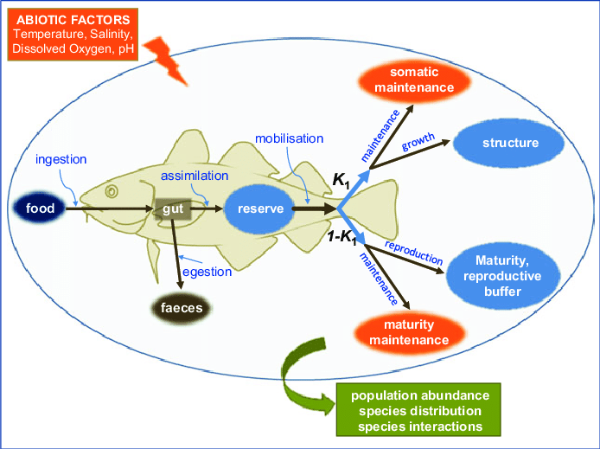
individual
Individual: metabolism, behavior, life history.
Dynamic Energy Budget (DEB) Model
population
metapopulation
How does a fish’s metabolism change with temperature?
community
ecosystem
McKenzie et al 2016. Conservation Physiology
Notes:
Interactions of an individual with the environment

Slide 20
individual
Population = multiple individuals of the same species (conspecifics) in the same habitat
population
metapopulation
community
ecosystem
Notes:
Then, we scale up to the population

Slide 21
individual
Population = multiple individuals of the same species (conspecifics) in the same habitat
population
metapopulation
fish
(x)
community
How does the abundance of fish change through time?
ecosystem

Slide 22
Nested Models, including a class of model known as Integral Projection Models (IPMs), link individual- and population-level processes
individual
population
metapopulation
fish
(x)
community
How does the abundance of fish change through time as temperature changes metabolism?
ecosystem

Slide 23
Metapopulation = sub-populations of conspecifics connected by migration or dispersal
individual
population
metapopulation
community
ecosystem
Notes:
Then to the metapop

Slide 24
Metapopulation = sub-populations of conspecifics connected by migration or dispersal
individual
population
fish₁
(x₁)
metapopulation
fish₂
(x₂)
community
How do the abundances of different subpopulations of the same fish vary in space [and time]?
fish₃
(x₃)
ecosystem
Notes:
Then to the metapop

Slide 25
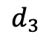
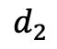
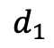
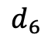
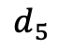
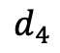
Metapopulation = sub-populations of conspecifics connected by migration or dispersal
individual
population
1
$$d_{1}$$
starfish₁
(x₁)
$$d_{2}$$
metapopulation
2
1
$$d_{6}$$
starfish₂
(x₂)
community
$$d_{5}$$
$$d_{3}$$
3
2
How do the abundances of different subpopulations of the same fish vary in space [and time]?
starfish₃
(x₃)
ecosystem
$$d_{4}$$
3

Slide 26
Community = interacting populations of different species
individual
population
metapopulation
community
ecosystem
Notes:
Then, we look at interactions between species

Slide 27
Community = interacting populations of different species
individual
population
fish
(x)
metapopulation
shark
(y)
community
How does fish abundance vary with changes in shark abundance?
ecosystem

Slide 28
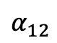
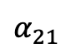
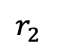
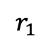
Community = interacting populations of different species
individual
population
$$α_{12}$$
$$r_{1}$$
metapopulation
Fish A
(x₁)
Fish B
(x₂)
$$r_{2}$$
community
$$α_{21}$$
How does the abundance of fish species A vary with changes in the abundance of fish species B?
ecosystem

Slide 29
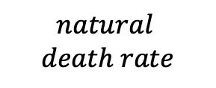
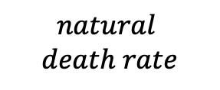
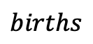
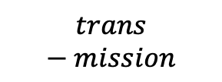
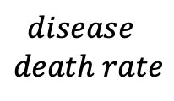
Community = interacting populations of different species
individual
population
$$births$$
Healthy
Fish
(susceptible)
$$trans−mission$$
Sick Fish (infected)
$$disease$$
$$death rate$$
metapopulation
$$natural$$
$$death rate$$
$$natural$$
$$death rate$$
community
How does the abundance of fish change based on infection with Mycobacterium marinum (wasting disease)?
ecosystem

Slide 30
Ecosystem = communities interacting with the abiotic environment
individual
population
metapopulation
community
ecosystem
Notes:
And finally how multiple species interact with each other – and with the environment

Slide 31
Ecosystem = communities interacting with the abiotic environment
individual
population
fish
(x)
metapopulation
(t)
shark
(y)
community
How does fish abundance vary with changes in shark birth rates with temperature?
ecosystem
Notes:
And finally how multiple species interact with each other – and with the environment

Slide 32
Ecosystem = communities interacting with the abiotic environment
individual
population
There is often less emphasis on the box model approach and more of a conceptual model approach to explain the distribution and abundance of species in space and time
metapopulation
community
ecosystem
Notes:
At the bottom, there is the level of the individual. Since ecology concerns interactions of organisms with each other and the environment, here we means how an in individual interacts with the environment

Slide 33
Ecosystem = communities interacting with the abiotic environment
individual
population
There is often less emphasis on the box model approach and more of a conceptual model approach to explain the distribution and abundance of species in space and time
metapopulation
community
How do communities assemble?
Do they end up the same in different environments?
ecosystem
Notes:
At the bottom, there is the level of the individual. Since ecology concerns interactions of organisms with each other and the environment, here we means how an in individual interacts with the environment

Slide 34
The field of biogeography studies the geographical distribution of plants and animals

Slide 35
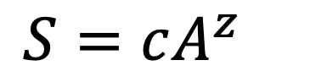
The field of biogeography studies the geographical distribution of plants and animals
Larger areas have more species!
$$S=cA^{z}$$
Preston 1964. Ecology

Slide 36
The field of biogeography studies the geographical distribution of plants and animals
Larger areas have more species!
$$S=cA^{z}$$
number of species
habitat area
Preston 1964. Ecology

Slide 37
The field of biogeography studies the geographical distribution of plants and animals
Larger areas have more species!
$$S=cA^{z}$$
slope of relationship in log-log space
number of species
habitat area
Preston 1964. Ecology

Slide 38
The field of biogeography studies the geographical distribution of plants and animals
Larger areas have more species!
$$S=cA^{z}$$
slope of relationship in log-log space
number of species
habitat area
constant based on unit of area
(standardizes to expected number of species per single unit area)
Preston 1964. Ecology

Slide 39
The field of biogeography studies the geographical distribution of plants and animals
Larger areas have more species!
The slope of the log-log relationship (z) will differ across diverse communities and ecosystems.
$$S=cA^{z}$$
Preston 1964. Ecology

Slide 40
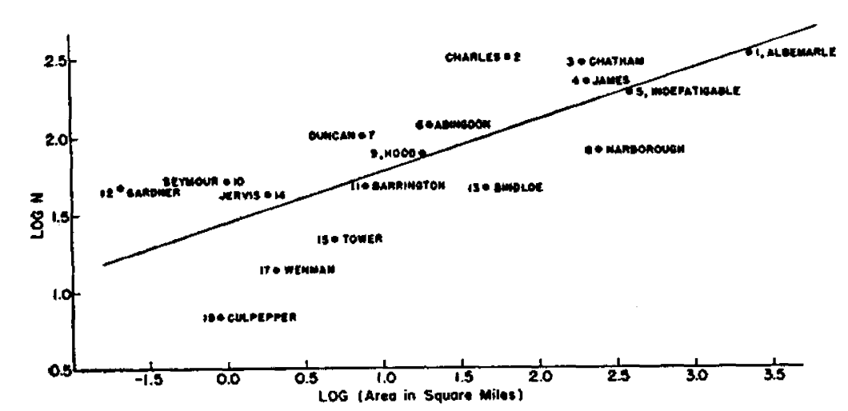
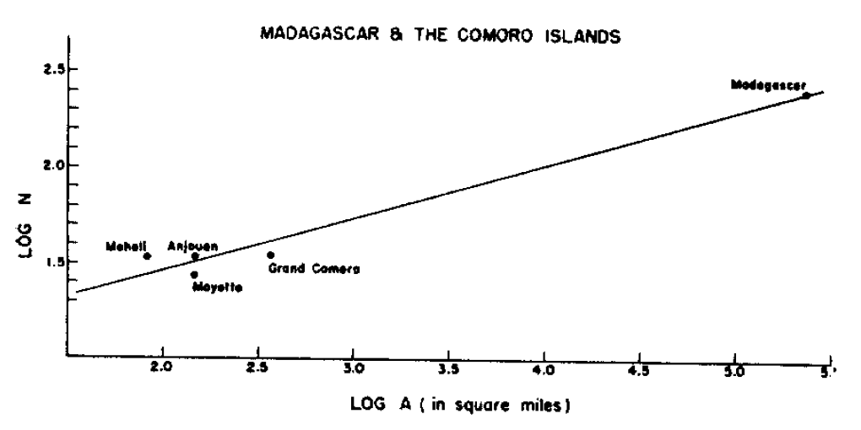
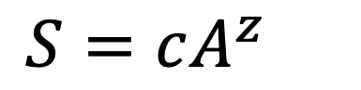
The field of biogeography studies the geographical distribution of plants and animals
Plant species of the Galapagos islands
Larger areas have more species!
The slope of the log-log relationship (z) will differ across diverse communities and ecosystems.
$$S=cA^{z}$$
Bird species of Madagascar and the Comoros
Preston 1964. Ecology

Slide 41
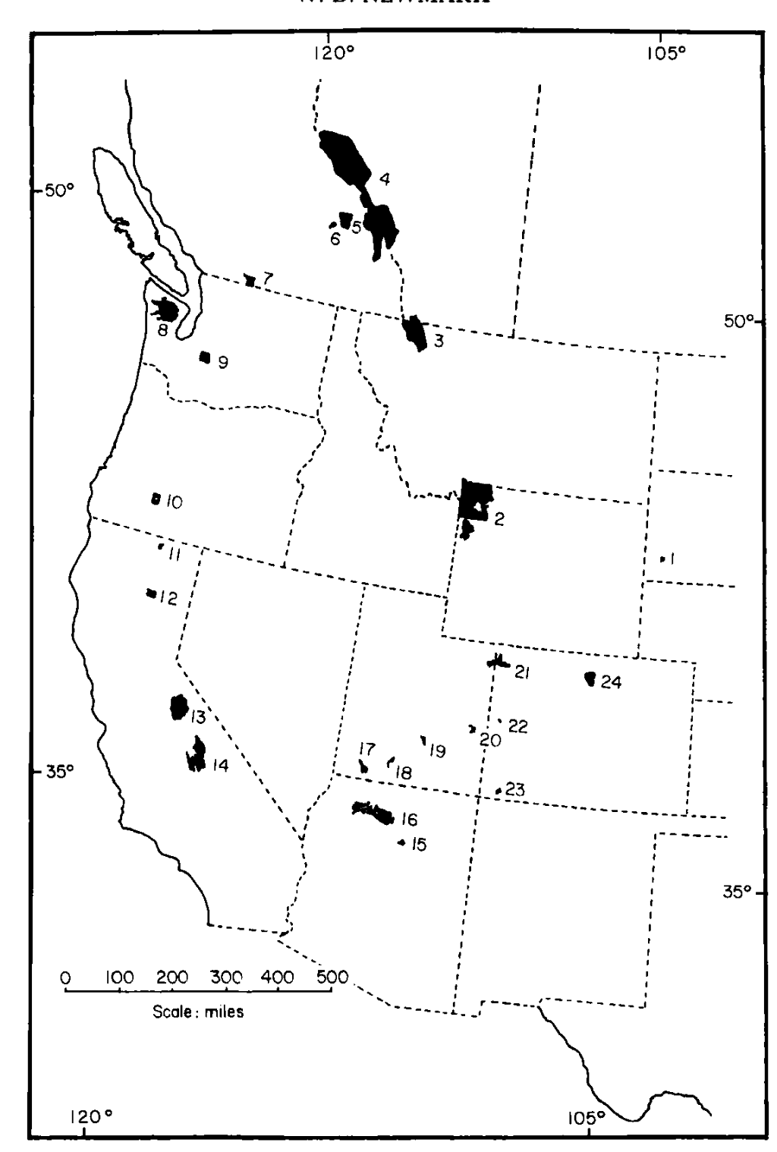
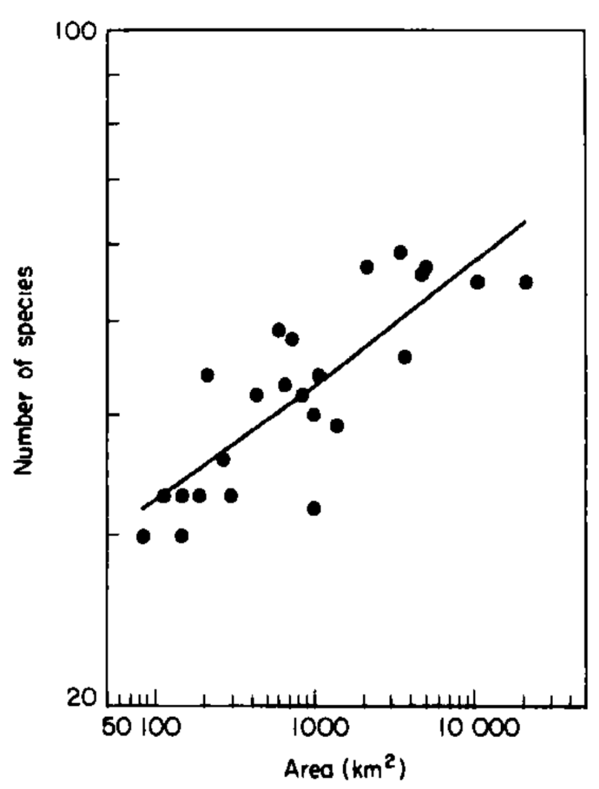
The field of biogeography studies the geographical distribution of plants and animals.
Mammal species of western US national parks
Larger areas have more species!
The slope of the log-log relationship (z) will differ across diverse communities and ecosystems.
$$S=cA^{z}$$
Newmark 1986. Biological Journal of the Linnean Society.

Slide 42
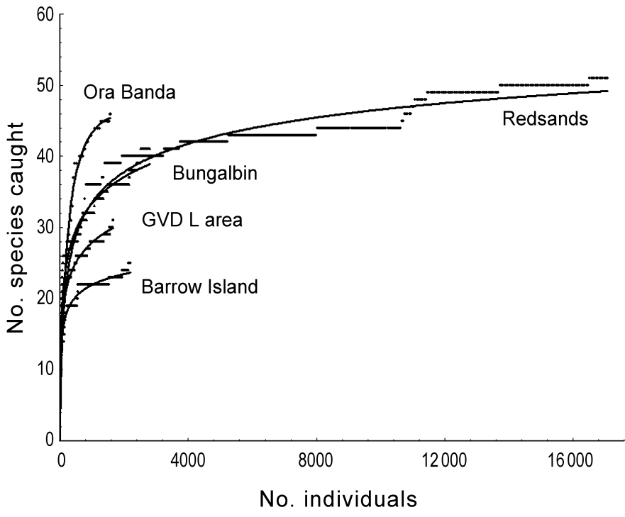
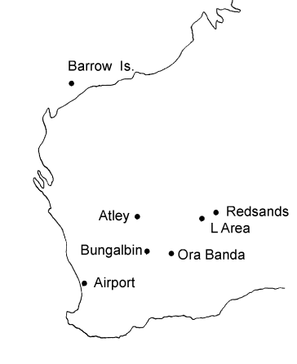
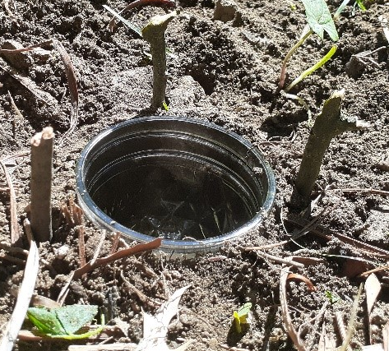
We can use the species-area relationship (SAR) to build species accumulation curves to understand if we have representatively sampled a population in field studies.
No. species captured
No. individuals captured
Thompson 2003. Animal Ecology.

Slide 43
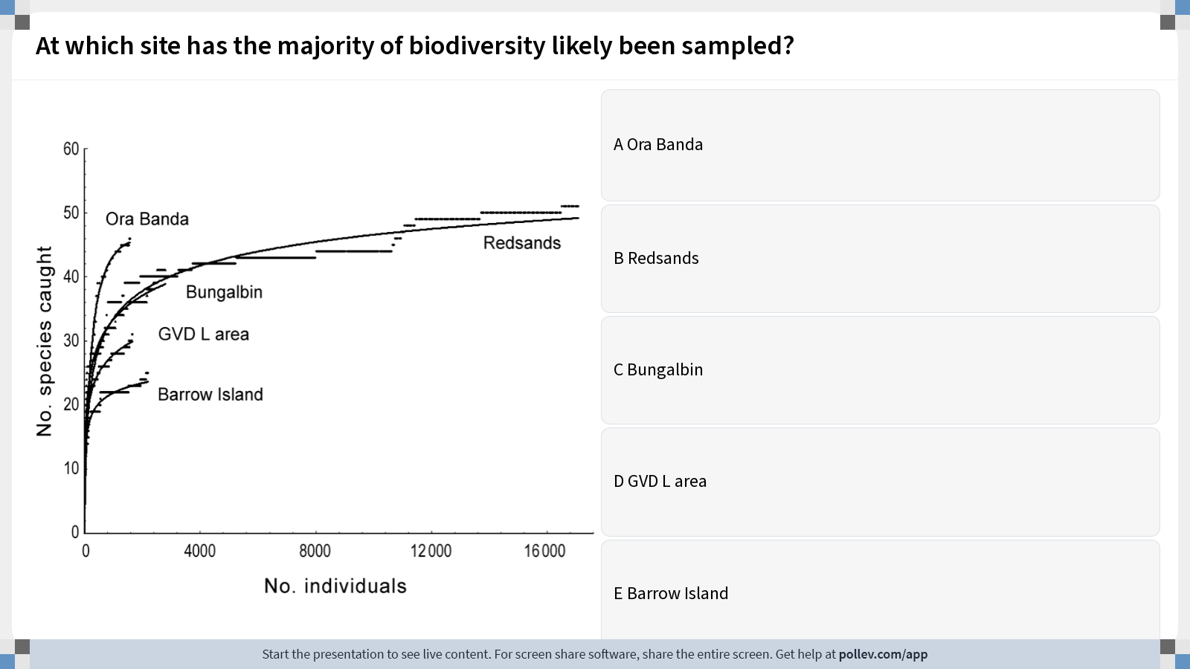
Notes:
Do not modify the notes in this section to avoid tampering with the Poll Everywhere activity. More info at polleverywhere.com/support At which site has the majority of biodiversity likely been sampled?
https://www.polleverywhere.com/multiple_choice_polls/GbP9DSSCQBRySuc3bFkGo?display_state=instructions&activity_state=opened&state=opened&flow=Instructor&onscreen=persist

Slide 44
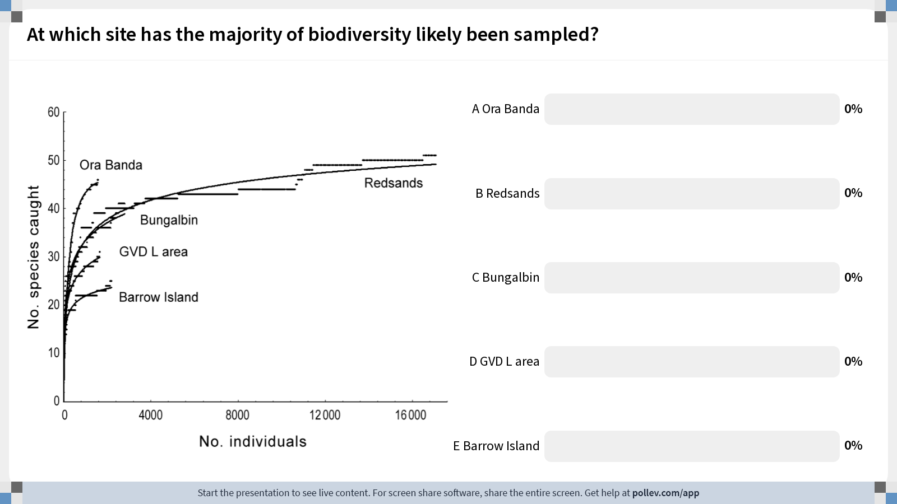
Notes:
Do not modify the notes in this section to avoid tampering with the Poll Everywhere activity. More info at polleverywhere.com/support At which site has the majority of biodiversity likely been sampled?
https://www.polleverywhere.com/multiple_choice_polls/GbP9DSSCQBRySuc3bFkGo?display_state=chart&activity_state=closed&state=closed&flow=Instructor&onscreen=persist

Slide 45
Notes:
Do not modify the notes in this section to avoid tampering with the Poll Everywhere activity. More info at polleverywhere.com/support At which site has the majority of biodiversity likely been sampled?
https://www.polleverywhere.com/multiple_choice_polls/GbP9DSSCQBRySuc3bFkGo?display_state=chart&activity_state=closed&display=correctness&state=closed&flow=Instructor&onscreen=persist

Slide 46
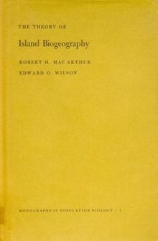
Building on the species-area relationship (SAR), MacArthur and Wilson proposed the theory of island biogeography.
MacArthur and Wilson. 1963. Evolution.
MacArthur and Wilson. 1967. The Theory of Island Biogeography.

Slide 47
Building on the species-area relationship (SAR), MacArthur and Wilson proposed the theory of island biogeography.
This theory offers a null model for the number of species found in a given habitat, predictable from both the size of the habitat and its distance from a source population.
MacArthur and Wilson. 1963. Evolution.
MacArthur and Wilson. 1967. The Theory of Island Biogeography.

Slide 48
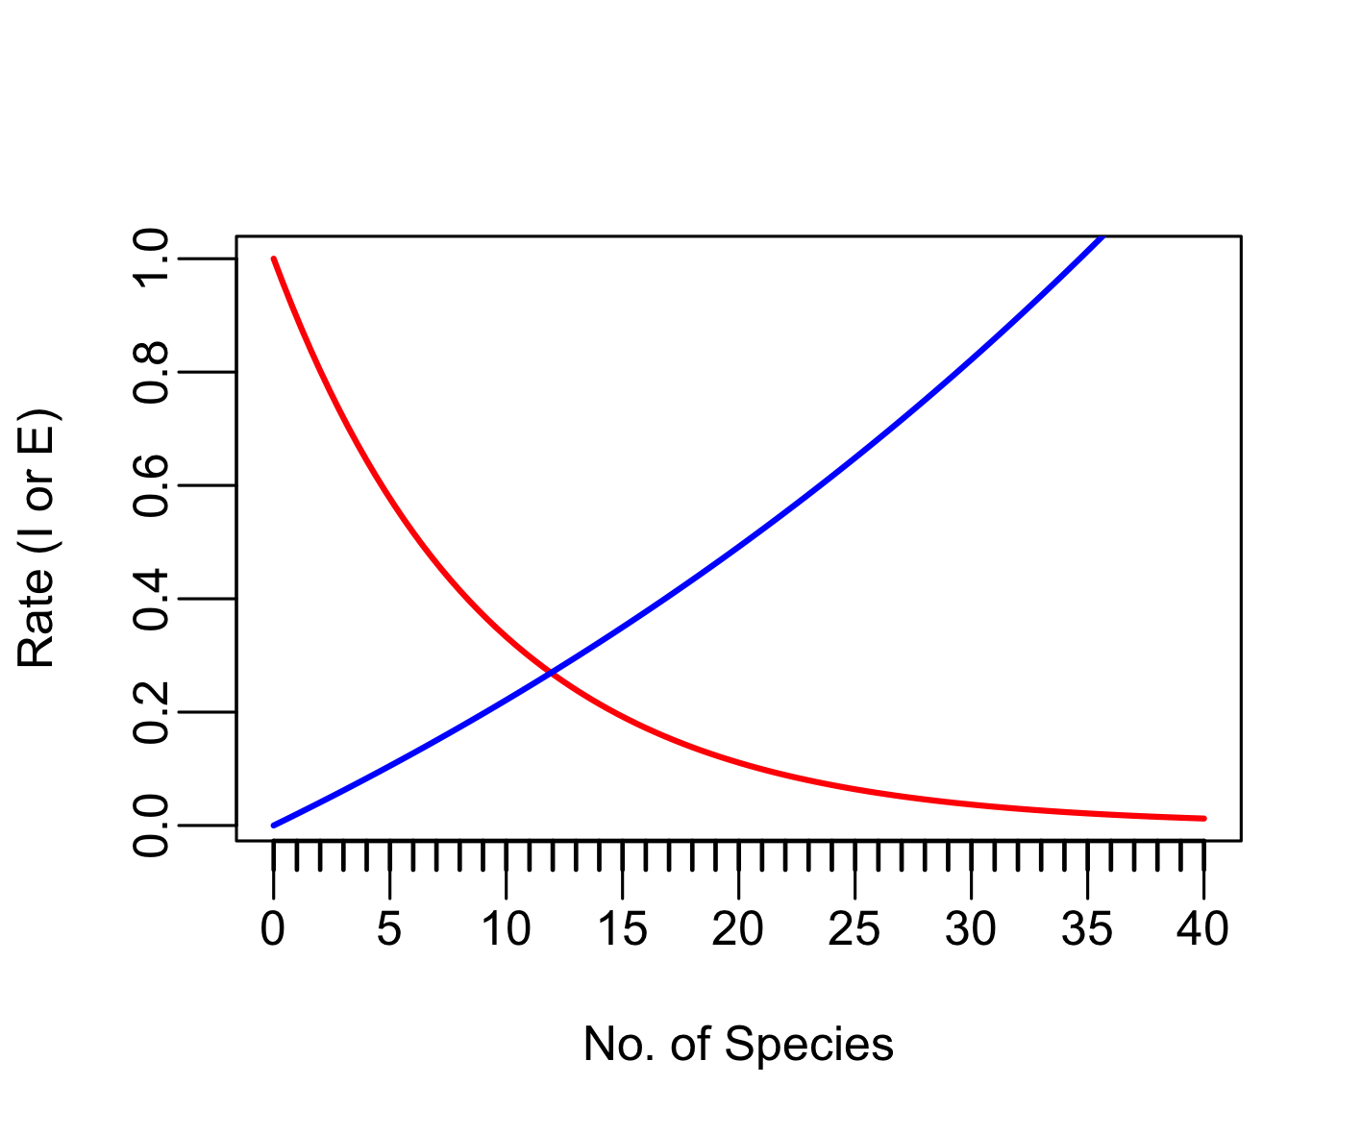
The theory of island biogeography offers a null model for the number of species found in a given habitat, predictable from both the size of the habitat and its distance from a source population.
The equilibrium number of species in
an “island” habitat is reached when:
the rate of immigration = the rate of extinction
Immigration
Extinction
MacArthur and Wilson. 1963. Evolution.
MacArthur and Wilson. 1967. The Theory of Island Biogeography.

Slide 49
The theory of island biogeography offers a null model for the number of species found in a given habitat, predictable from both the size of the habitat and its distance from a source population.
Species area-effect: Larger islands have lower extinction rates because they provide more habitat to sustain more species. Allee effects reduced at larger population sizes.
The equilibrium number of species in
an “island” habitat is reached when:
the rate of immigration = the rate of extinction
Immigration
Extinction
N=100
N=10
MacArthur and Wilson. 1963. Evolution.
MacArthur and Wilson. 1967. The Theory of Island Biogeography.

Slide 50
The theory of island biogeography offers a null model for the number of species found in a given habitat, predictable from both the size of the habitat and its distance from a source population.
Distance effect: Closer islands have higher immigration rates because it’s easier for organisms to disperse across short distances.
Species area-effect: Larger islands have lower extinction rates because they provide more habitat to sustain more species. Allee effects reduced at larger population sizes.
The equilibrium number of species in
an “island” habitat is reached when:
the rate of immigration = the rate of extinction
Immigration
Extinction
N=100
N=10
MacArthur and Wilson. 1963. Evolution.
MacArthur and Wilson. 1967. The Theory of Island Biogeography.

Slide 51
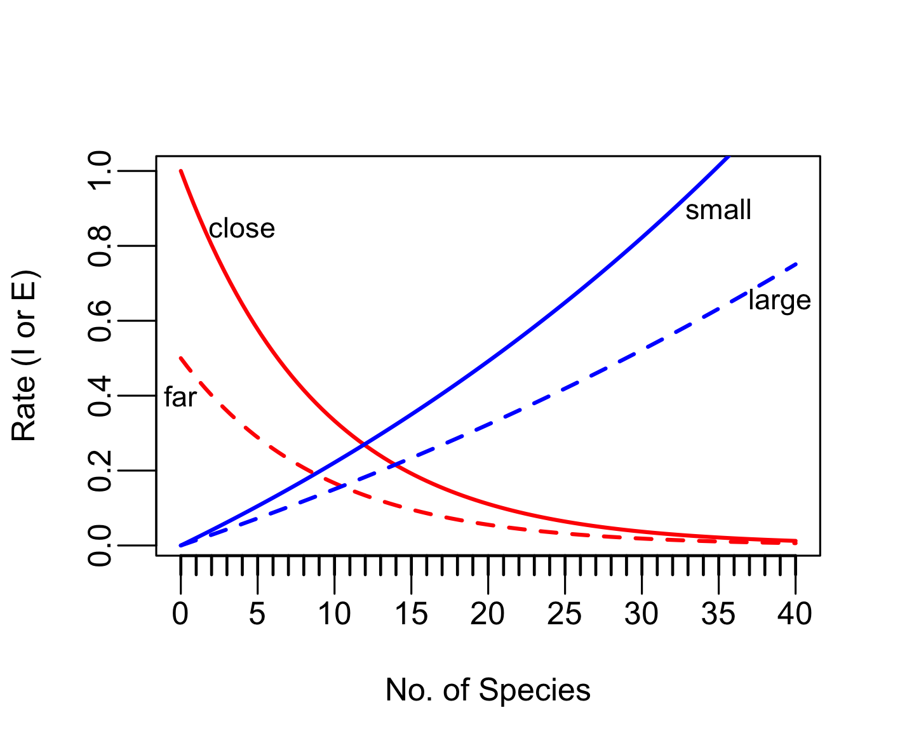
The theory of island biogeography offers a null model for the number of species found in a given habitat, predictable from both the size of the habitat and its distance from a source population.
Distance effect: Closer islands have higher immigration rates because it’s easier for organisms to disperse across short distances.
Species area-effect: Larger islands have lower extinction rates because they provide more habitat to sustain more species. Allee effects reduced at larger population sizes.
The equilibrium number of species in
an “island” habitat is reached when:
the rate of immigration = the rate of extinction
Immigration
Extinction
N=100
N=10
MacArthur and Wilson. 1963. Evolution.
MacArthur and Wilson. 1967. The Theory of Island Biogeography.

Slide 52
The theory of island biogeography offers a null model for the number of species found in a given habitat, predictable from both the size of the habitat and its distance from a source population.
Distance effect: Closer islands have higher immigration rates because it’s easier for organisms to disperse across short distances.
Species area-effect: Larger islands have lower extinction rates because they provide more habitat to sustain more species. Allee effects reduced at larger population sizes.
The equilibrium number of species in
an “island” habitat is reached when:
the rate of immigration = the rate of extinction
Immigration
Extinction
turnover rate for far-small
S*: far-small
MacArthur and Wilson. 1963. Evolution.
MacArthur and Wilson. 1967. The Theory of Island Biogeography.

Slide 53
The theory of island biogeography offers a null model for the number of species found in a given habitat, predictable from both the size of the habitat and its distance from a source population.
Distance effect: Closer islands have higher immigration rates because it’s easier for organisms to disperse across short distances.
Species area-effect: Larger islands have lower extinction rates because they provide more habitat to sustain more species. Allee effects reduced at larger population sizes.
The equilibrium number of species in
an “island” habitat is reached when:
the rate of immigration = the rate of extinction
Immigration
Extinction
S*: far-small
S*: close-large
S*: far-large
S*: close-small

Slide 54
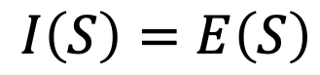
The theory of island biogeography offers a null model for the number of species found in a given habitat, predictable from both the size of the habitat and its distance from a source population.
Distance effect: Closer islands have higher immigration rates because it’s easier for organisms to disperse across short distances.
The equilibrium number of species in
an “island” habitat is reached when:
the rate of immigration = the rate of extinction
Species area-effect: Larger islands have lower extinction rates because they provide more habitat to sustain more species. Allee effects reduced at larger population sizes.
$$I\left(S\right)=E\left(S\right)$$
Immigration
Extinction

Slide 55
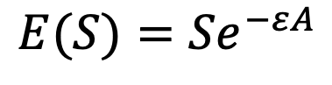
The theory of island biogeography offers a null model for the number of species found in a given habitat, predictable from both the size of the habitat and its distance from a source population.
Distance effect: Closer islands have higher immigration rates because it’s easier for organisms to disperse across short distances.
The equilibrium number of species in
an “island” habitat is reached when:
the rate of immigration = the rate of extinction
Species area-effect: Larger islands have lower extinction rates because they provide more habitat to sustain more species. Allee effects reduced at larger population sizes.
$$I\left(S\right)=E\left(S\right)$$
Immigration
Extinction
$$E(S)={Se}^{−εA}$$
fit parameter scaling effect of area on extinction
area of habitat
number of species on island

Slide 56
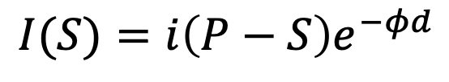
The theory of island biogeography offers a null model for the number of species found in a given habitat, predictable from both the size of the habitat and its distance from a source population.
Distance effect: Closer islands have higher immigration rates because it’s easier for organisms to disperse across short distances.
The equilibrium number of species in
an “island” habitat is reached when:
the rate of immigration = the rate of extinction
Species area-effect: Larger islands have lower extinction rates because they provide more habitat to sustain more species. Allee effects reduced at larger population sizes.
$$I\left(S\right)=E\left(S\right)$$
$$I(S)={i\left(P−S\right)e}^{−φd}$$
Immigration
Extinction
$$E(S)={Se}^{−εA}$$
distance from island to source population
immigration rate
number of species on island
area of habitat
number of species on island
fit parameter scaling effect of area on extinction
total number of species in pool
fit parameter governing distance decay on immigration rate

Slide 57
The theory of island biogeography offers a null model for the number of species found in a given habitat, predictable from both the size of the habitat and its distance from a source population.
Distance effect: Closer islands have higher immigration rates because it’s easier for organisms to disperse across short distances.
The equilibrium number of species in
an “island” habitat is reached when:
the rate of immigration = the rate of extinction
Species area-effect: Larger islands have lower extinction rates because they provide more habitat to sustain more species. Allee effects reduced at larger population sizes.
$$I\left(S\right)=E\left(S\right)$$
$$I(S)={i\left(P−S\right)e}^{−φd}$$
Immigration
Extinction
$$E(S)={Se}^{−εA}$$
distance from island to source population
immigration rate
number of species on island
area of habitat
number of species on island
fit parameter scaling effect of area on extinction
total number of species in pool
fit parameter governing distance decay on immigration rate

Slide 58
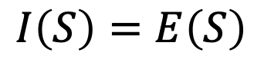
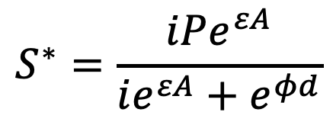
The theory of island biogeography offers a null model for the number of species found in a given habitat, predictable from both the size of the habitat and its distance from a source population.
The equilibrium number of species in
an “island” habitat is reached when:
the rate of immigration = the rate of extinction
$$I\left(S\right)=E\left(S\right)$$
Immigration
Extinction
$$S^{∗}=\frac{iPe^{εA}}{ie^{εA}+e^{φd}}$$
MacArthur and Wilson. 1963. Evolution.
MacArthur and Wilson. 1967. The Theory of Island Biogeography.

Slide 59
The theory of island biogeography offers a null model for the number of species found in a given habitat, predictable from both the size of the habitat and its distance from a source population.
The equilibrium number of species in
an “island” habitat is reached when:
the rate of immigration = the rate of extinction
increases with number of species in source pool
increases with area of island
Immigration
Extinction
$$S^{∗}=\frac{iPe^{εA}}{ie^{εA}+e^{φd}}$$
decreases with distance from with distance from mainland
equilibrium number of species
MacArthur and Wilson. 1963. Evolution.
MacArthur and Wilson. 1967. The Theory of Island Biogeography.

Slide 60
Extensions to the theory of island biogeography…
Species area-effect: Larger islands have lower extinction rates because they provide more habitat to sustain more species. Allee effects reduced at larger population sizes.
Distance effect: Closer islands have higher immigration rates because it’s easier for organisms to disperse across short distances.
The equilibrium number of species in
an “island” habitat is reached when:
the rate of immigration = the rate of extinction
Immigration
Extinction
N=100
N=10

Slide 61
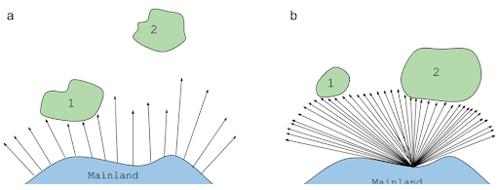
Extensions to the theory of island biogeography…
Species area-effect: Larger islands have lower extinction rates because they provide more habitat to sustain more species. Allee effects reduced at larger population sizes.
Distance effect: Closer islands have higher immigration rates because it’s easier for organisms to disperse across short distances.
The equilibrium number of species in
an “island” habitat is reached when:
the rate of immigration = the rate of extinction
Immigration
Target effect: larger islands have higher immigration rates because they offer a bigger target to land on!
Extinction
Rescue effect: Closer islands have lower extinction rates because they can be repopulated from the mainland!

Slide 62
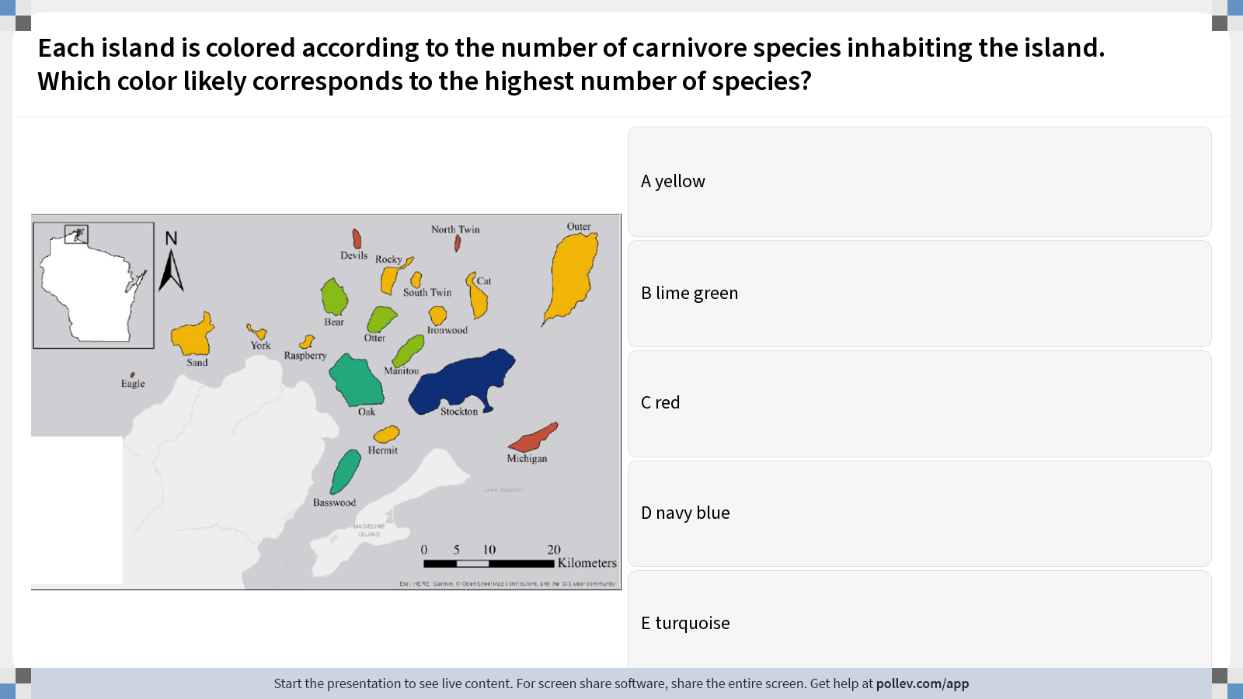
Notes:
Do not modify the notes in this section to avoid tampering with the Poll Everywhere activity. More info at polleverywhere.com/support Each island is colored according to the number of carnivore species inhabiting the island. Which color likely corresponds to the highest number of species?
https://www.polleverywhere.com/multiple_choice_polls/t0xuGVuH0WyvPAy2bgArC?display_state=instructions&activity_state=opened&state=opened&flow=Instructor&onscreen=persist

Slide 63
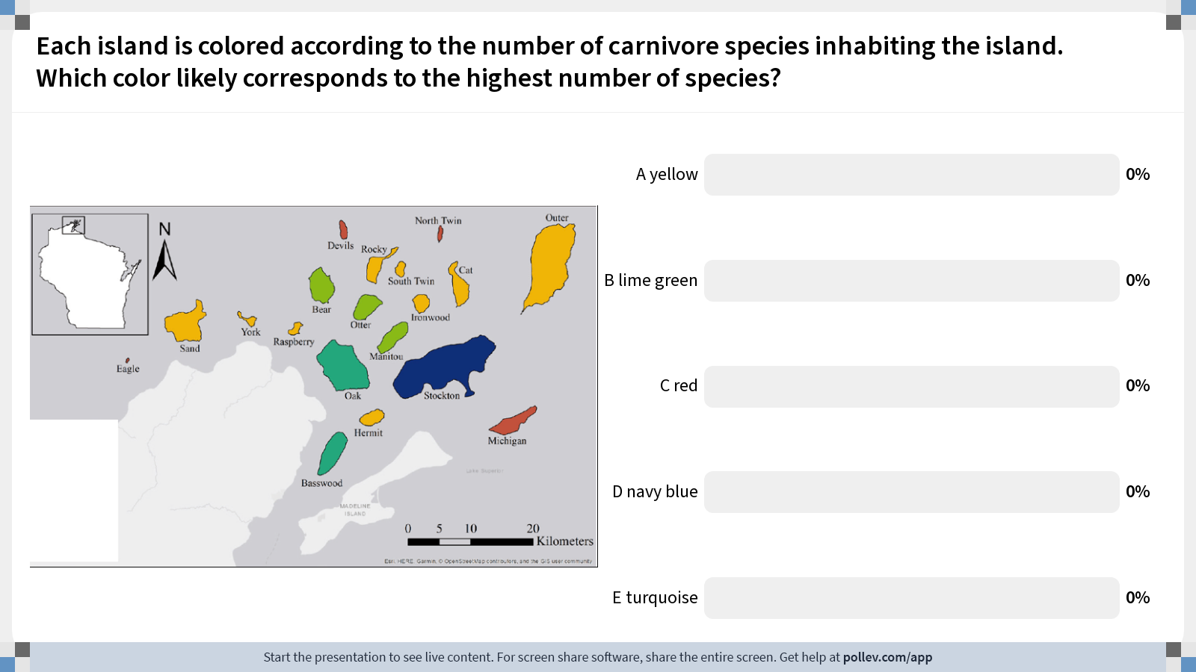
Notes:
Do not modify the notes in this section to avoid tampering with the Poll Everywhere activity. More info at polleverywhere.com/support Each island is colored according to the number of carnivore species inhabiting the island. Which color likely corresponds to the highest number of species?
https://www.polleverywhere.com/multiple_choice_polls/t0xuGVuH0WyvPAy2bgArC?display_state=chart&activity_state=closed&state=closed&flow=Instructor&onscreen=persist

Slide 64
Notes:
Do not modify the notes in this section to avoid tampering with the Poll Everywhere activity. More info at polleverywhere.com/support Each island is colored according to the number of carnivore species inhabiting the island. Which color likely corresponds to the highest number of species?
https://www.polleverywhere.com/multiple_choice_polls/t0xuGVuH0WyvPAy2bgArC?display_state=chart&activity_state=closed&display=correctness&state=closed&flow=Instructor&onscreen=persist

Slide 65
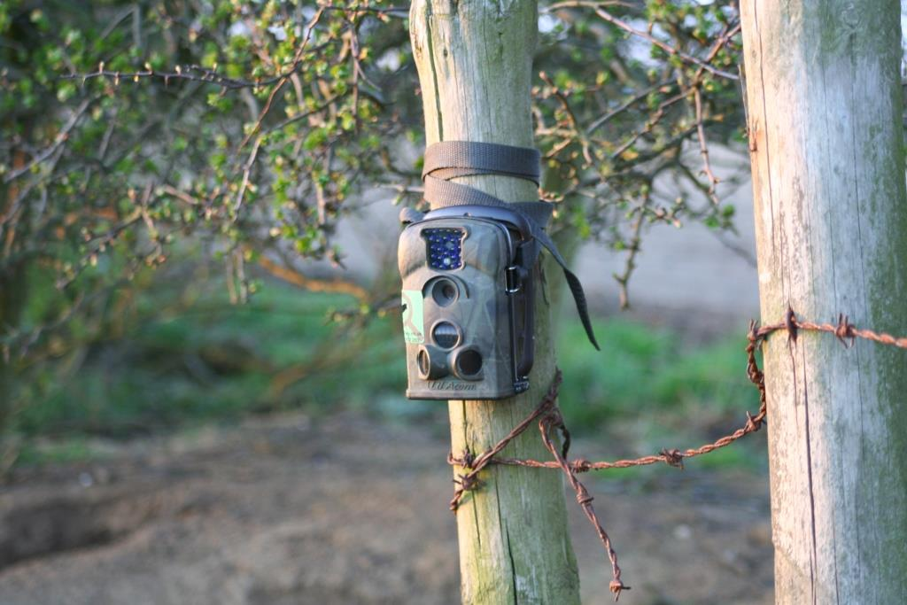
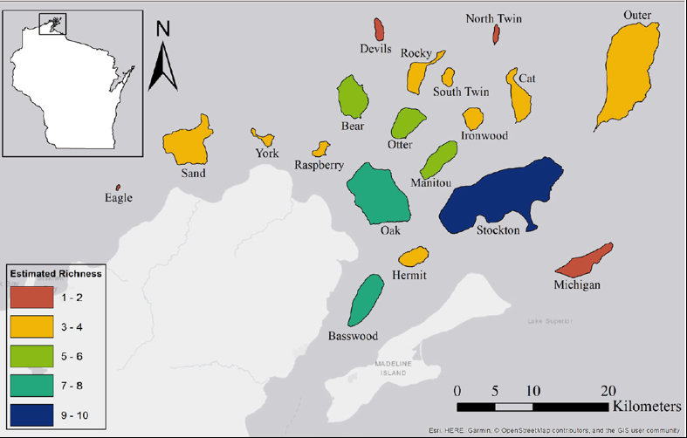
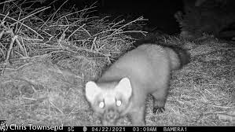
The importance of island size vs. distance varied for different species!
Allen et al. 2018. Community Ecology.

Slide 66
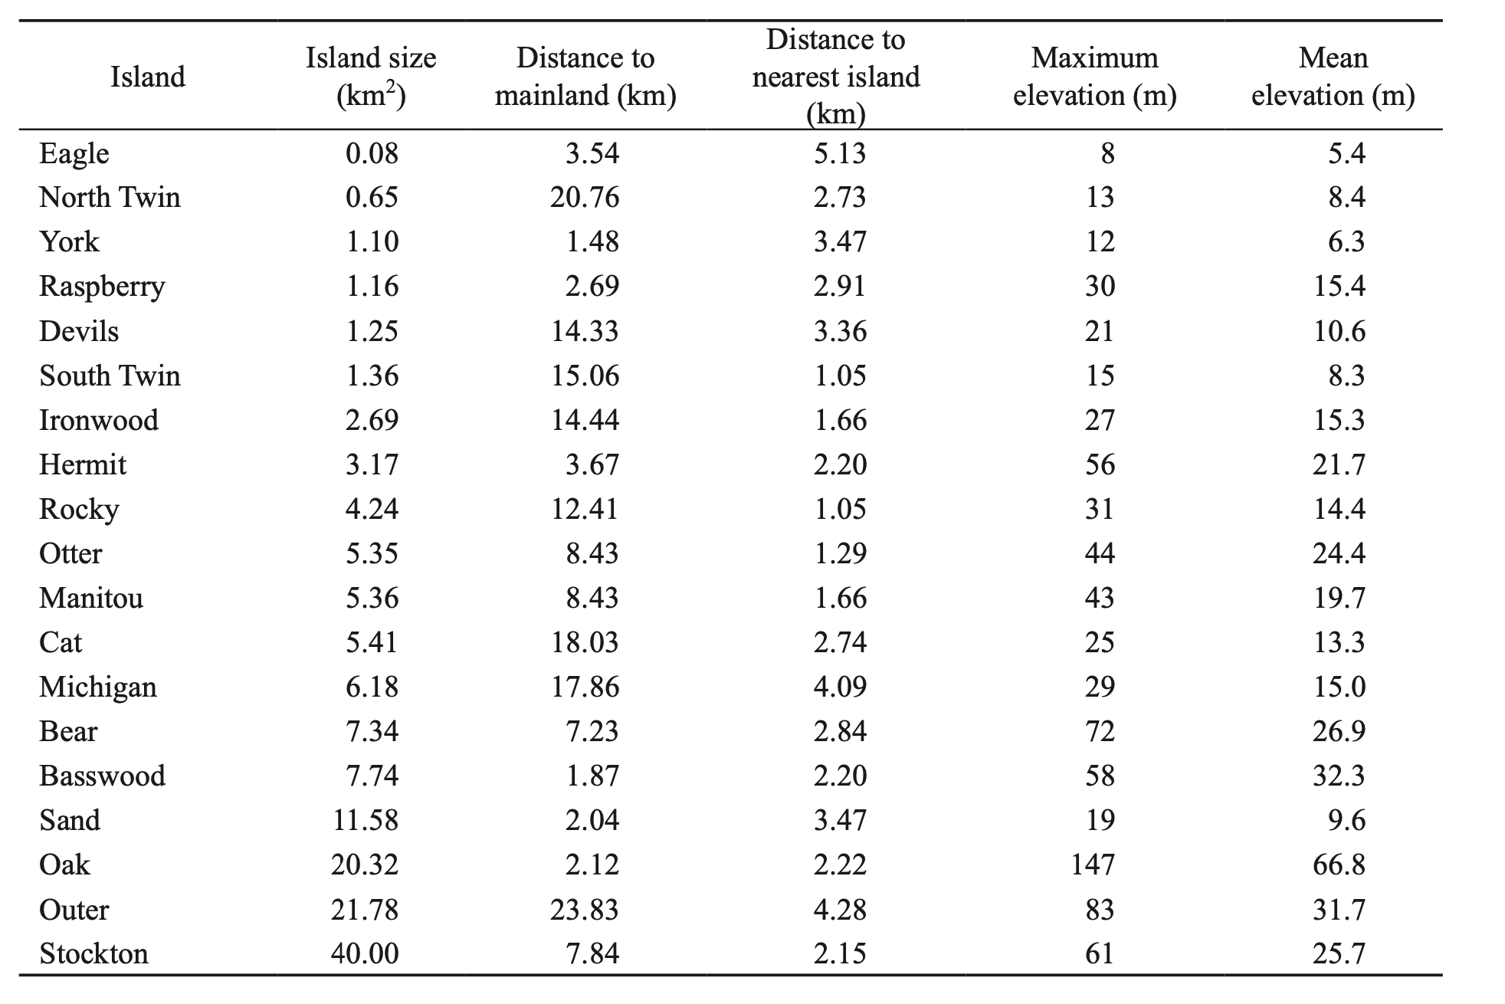
The importance of island size vs. distance varied for different species!
Coyotes – density predicted by (1) island size, (2) distance from mainland, (3) inter-island distances
Black bears – predicted by (1) island size and (3) inter-island distances only
Weasels – not predicted by any of these variables
Allen et al. 2018. Community Ecology.

Slide 67
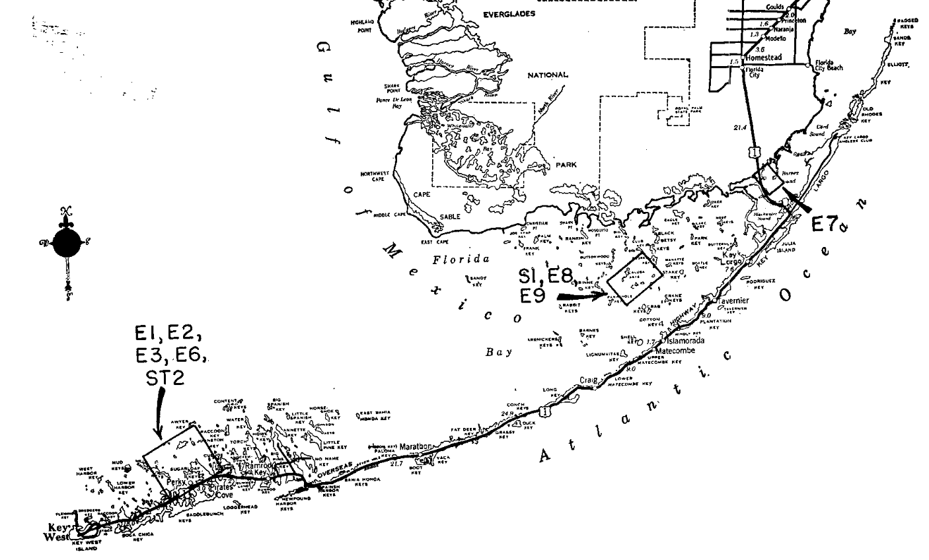
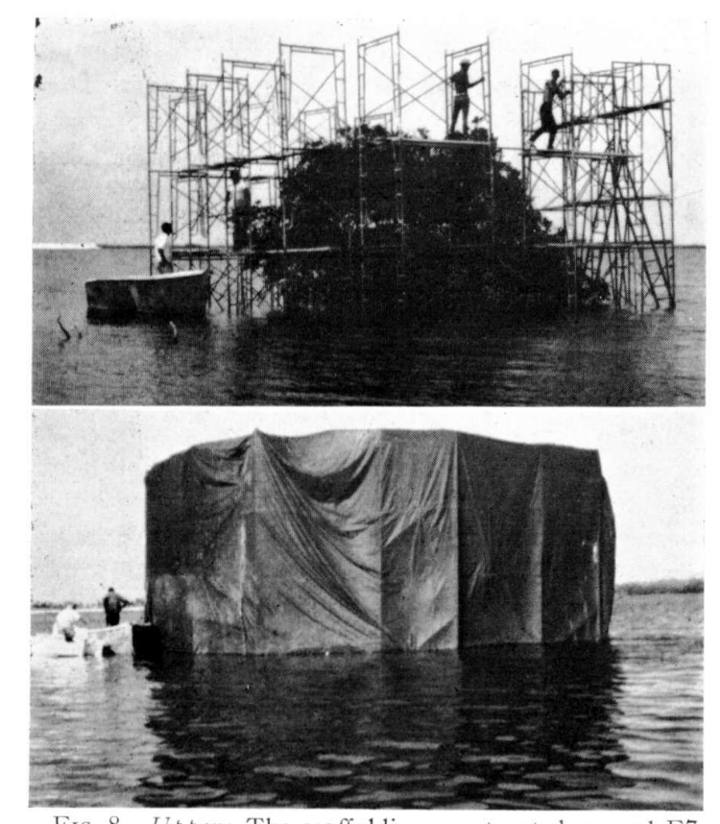
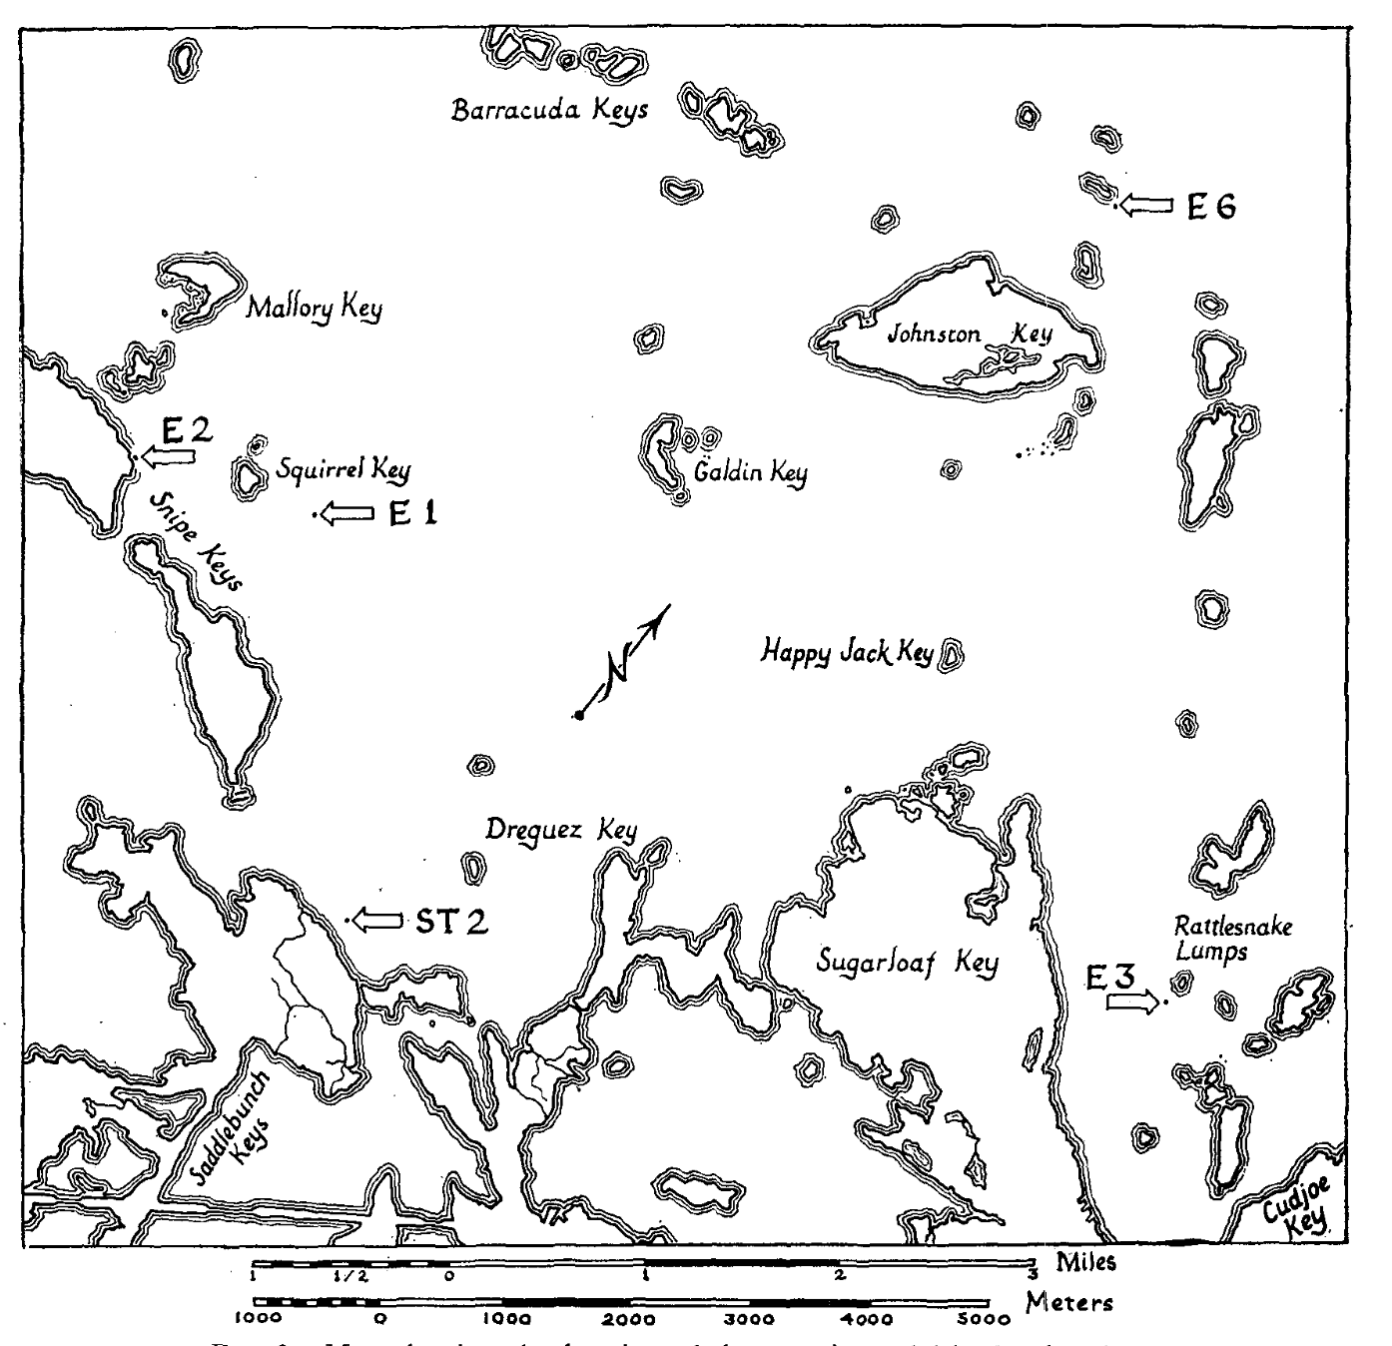
Wilson and Simberloff field-tested island biogeography theory in the Florida Keys!
Wilson and Simberloff identified seven mangrove islands in the Florida Keys varying in size from 11-18m in diameter and catalogued their fauna (all arthropods).
They also conducted surveys across the keys to quantify the entire possible “source” pool to the islands.
The experimental islands were then fumigated with methyl bromide at levels lethal to arthropods but not to plants.
They catalogued their progressive recolonization after fumigation, tracking its predictability based on size and distance of these islands to the source pool.
Simberloff. 1969. Ecology.
Wilson and Simberloff. 1969. Ecology.
Simberloff and Wilson. 1969. Ecology.

Slide 68
Wilson and Simberloff field-tested island biogeography theory in the Florida Keys!
Wilson and Simberloff identified seven mangrove islands in the Florida Keys varying in size from 11-18m in diameter and catalogued their fauna (all arthropods).
They also conducted surveys across the keys to quantify the entire possible “source” pool to the islands.
The experimental islands were then fumigated with methyl bromide at levels lethal to arthropods but not to plants.
They catalogued their progressive recolonization after fumigation, tracking its predictability based on size and distance of these islands to the source pool.
Simberloff. 1969. Ecology.
Wilson and Simberloff. 1969. Ecology.
Simberloff and Wilson. 1969. Ecology.

Slide 69
Wilson and Simberloff field-tested island biogeography theory in the Florida Keys!
Wilson and Simberloff identified seven mangrove islands in the Florida Keys varying in size from 11-18m in diameter and catalogued their fauna (all arthropods).
They also conducted surveys across the keys to quantify the entire possible “source” pool to the islands.
The experimental islands were then fumigated with methyl bromide at levels lethal to arthropods but not to plants.
They catalogued their progressive recolonization after fumigation, tracking its predictability based on size and distance of these islands to the source pool.
Simberloff. 1969. Ecology.
Wilson and Simberloff. 1969. Ecology.
Simberloff and Wilson. 1969. Ecology.

Slide 70
Wilson and Simberloff field-tested island biogeography theory in the Florida Keys!
Wilson and Simberloff identified seven mangrove islands in the Florida Keys varying in size from 11-18m in diameter and catalogued their fauna (all arthropods).
They also conducted surveys across the keys to quantify the entire possible “source” pool to the islands.
The experimental islands were then fumigated with methyl bromide at levels lethal to arthropods but not to plants.
They catalogued their progressive recolonization after fumigation, tracking its predictability based on size and distance of these islands to the source pool.
Simberloff. 1969. Ecology.
Wilson and Simberloff. 1969. Ecology.
Simberloff and Wilson. 1969. Ecology.

Slide 71
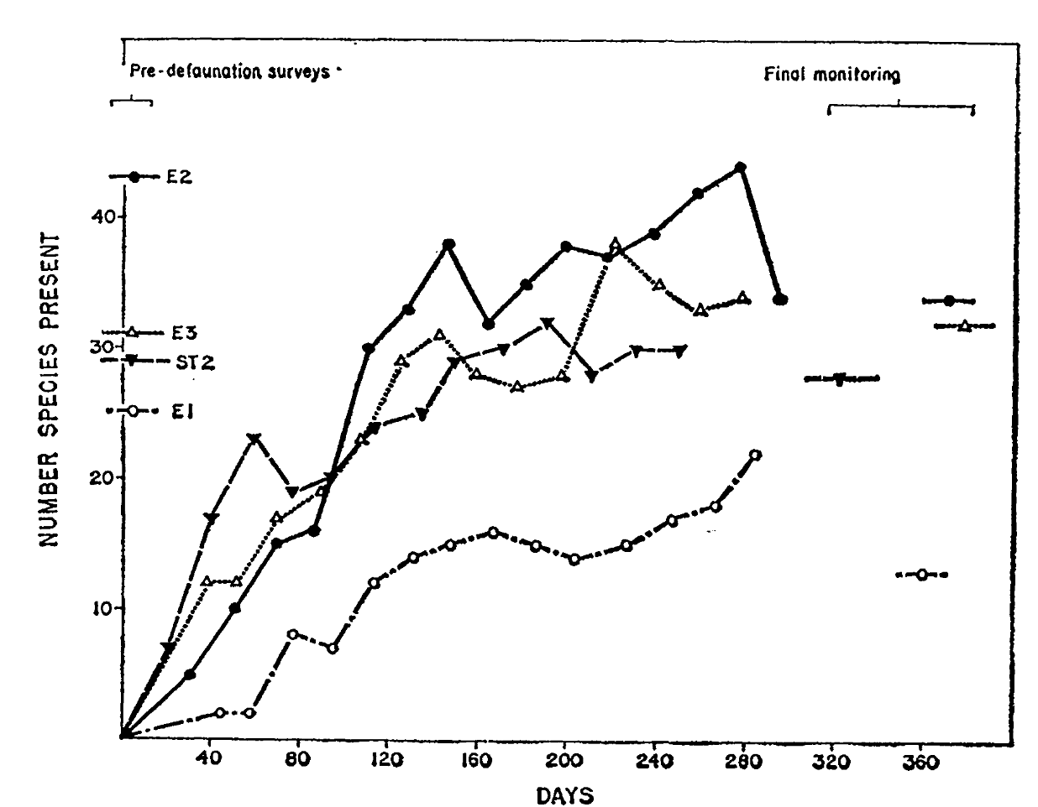

Wilson and Simberloff field-tested island biogeography theory in the Florida Keys!
Islands were recolonized to pre-defaunation levels rapidly, within a year!
Though the equilibrium number of species was the same, the identity was quite different – only about 40% similar to the original censuses.
Strong flyers recolonized first but were eventually replaced (outcompeted) by better competitors (typically ants) – in keeping with theories of faunal succession.
The islands farthest from the mainland were the slowest to recolonize.
Simberloff. 1969. Ecology.
Wilson and Simberloff. 1969. Ecology.
Simberloff and Wilson. 1969. Ecology.

Slide 72
Wilson and Simberloff field-tested island biogeography theory in the Florida Keys!
Islands were recolonized to pre-defaunation levels rapidly, within a year!
Though the equilibrium number of species was the same, the identity was quite different – only about 40% similar to the original censuses.
Strong flyers recolonized first but were eventually replaced (outcompeted) by better competitors (typically ants) – in keeping with theories of faunal succession.
The islands farthest from the mainland were the slowest to recolonize.
Simberloff. 1969. Ecology.
Wilson and Simberloff. 1969. Ecology.
Simberloff and Wilson. 1969. Ecology.

Slide 73
Wilson and Simberloff field-tested island biogeography theory in the Florida Keys!
Islands were recolonized to pre-defaunation levels rapidly, within a year!
Though the equilibrium number of species was the same, the identity was quite different – only about 40% similar to the original censuses.
Strong flyers recolonized first but were eventually replaced (outcompeted) by better competitors (typically ants) – in keeping with theories of faunal succession.
The islands farthest from the mainland were the slowest to recolonize.
Simberloff. 1969. Ecology.
Wilson and Simberloff. 1969. Ecology.
Simberloff and Wilson. 1969. Ecology.

Slide 74
Wilson and Simberloff field-tested island biogeography theory in the Florida Keys!
Islands were recolonized to pre-defaunation levels rapidly, within a year!
Though the equilibrium number of species was the same, the identity was quite different – only about 40% similar to the original censuses.
Strong flyers recolonized first but were eventually replaced (outcompeted) by better competitors (typically ants) – in keeping with theories of faunal succession.
The islands farthest from the mainland were the slowest to recolonize.
Simberloff. 1969. Ecology.
Wilson and Simberloff. 1969. Ecology.
Simberloff and Wilson. 1969. Ecology.

Slide 75



In subsequent work, Simberloff demonstrated the area effect by actually removing entire chunks out of islands and censusing species!
log-log plot of island area and species count before and after land removal!
Pre-land removal species accumulation curves demonstrate that a sufficient quantity of biodiversity was sampled.
Simberloff. 1976. Ecology.

Slide 76


Island biogeography has greatly influenced the design of protected area reserves
Area effect:
Island size and resident, non-marine bird species number near New Guinea
Distance effect:
Island resident, non-marine bird species count by distance from New Guinea (standardized by area)
Diamond. 1975. Biological Conservation.

Slide 77



Island biogeography has greatly influenced the design of protected area reserves
Mammalian extirpations post-establishment by area size in western North American national parks
“SLOSS” debate
(1970s-1980s)
Reserve design estimated to protect the largest number of species based on island biogeography theory
Newmark. 1987. Nature.
Diamond. 1975. Biological Conservation.

Slide 78
Population Biology
Conservation Biology
Disease Ecology
Goal:
protect populations from extinction
Concept:
Minimum Viable Population size (MVP)
Approach:
protected area reserves
Goal:
protect populations from disease via pathogen extinction
Concept:
Critical Community Size (CCS)
Approach:
sanitation
vaccination

Slide 79

Superorganisms vs. Loose Collections of Species?
Frederic Clements (1916) argued that community succession was predictable and deterministic, much like ontogenetic development in individual organisms, moving always towards some superorganism.
Priority effects: inhibitory or facilitative priority effects occur when one species ”prepares” the environment for the next species in succession
Henry Gleason (1926) argued instead that chance favored the dispersal of nearby species into available habitat for succession, leading to stochastic assembly of communities
Closer to Cowles’ original thinking

Slide 80



Niche-based assembly vs. Neutral theories of assembly?
Niche: match of a species to specific environmental conditions
Assembly will be deterministic
Joseph Grinnell (1917) – coined the term for the CA thrasher and its chapparal habitat. Includes physical match and behavioral adaptations
Neutral: species-specific differences within a trophic level will be irrelevant to their success
Assembly will be stochastic
MacArthur and Wilson 1967
Hubbell (2001) - Unified neutral theory of biodiversity and biogeography (UNTB)

Slide 81
Biodiversity can be measured in several ways!

Slide 82
Biodiversity can be measured in several ways!
Landscape A
Site 1
Site 2
Whittaker. 1960. Ecological Monographs.

Slide 83

Biodiversity can be measured in several ways!
(here = 3)
$α$ – diversity = species richness, typically within a small specified region
Landscape A
Site 1
Site 2
(here = 4)
Whittaker. 1960. Ecological Monographs.

Slide 84

Biodiversity can be measured in several ways!
(here = 3)
$α$ – diversity = species richness, typically within a small specified region
Landscape A
Site 1
$γ$ – diversity = total species diversity in a the landscape (here = 5)
Site 2
(here = 4)
Whittaker. 1960. Ecological Monographs.

Slide 85


Biodiversity can be measured in several ways!
(here = 3)
(here = 1.67 or 2)
$α$ – diversity = species richness, typically within a small specified region
Landscape A
Site 1
$γ$ – diversity = total species diversity in a the landscape (here = 5)
Site 2
(here = 1.25 or 1)
$β$– diversity = ratio between landscape and local species diversity, either $\left(\frac{γ}{α}\right)$ or $\left(γ\text{−}α\right)$
Site 1 has lower $α$– diversity but higher $β$– diversity than site 2. Both are important!
(here = 4)
Whittaker. 1960. Ecological Monographs.

Slide 86

Biodiversity is concentrated in the tropics.
(terrestrial vertebrate diversity)
Mannion. 2014. Trends in Ecology & Evolution.

Slide 87
Biodiversity is concentrated in the tropics.
We still lack a satisfying model to explain why.
(terrestrial vertebrate diversity)
Mannion. 2014. Trends in Ecology & Evolution.

Slide 88
Biodiversity is concentrated in the tropics.
We still lack a satisfying model to explain why.
Some candidate hypotheses:
Geographical area hypothesis. More area in the tropics = more species… but there’s just as much area north of the tropics and fewer species!
Species-energy hypothesis. Increased solar energy at low latitudes causes increased net primary productivity (or photosynthesis) and drives accumulation of species up the food web…but offers a better prediction for abundance and biomass than for numbers of species.
Historical perturbation hypothesis. Polar regions have not yet recovered equilibrium species numbers after glaciation… but does not hold for marine systems, where the latitudinal gradient still exists…
Biotic interactions hypothesis. More species yield more species as processes of competition, predation, etc. are intensified in the tropics… but cannot provide the basal cause for the accumulation of more species to begin with!
Mannion. 2014. Trends in Ecology & Evolution.

Slide 89
Biodiversity is concentrated in the tropics.
We still lack a satisfying model to explain why.
Some candidate hypotheses:
Geographical area hypothesis. More area in the tropics = more species… but there’s just as much area north of the tropics and fewer species!
Species-energy hypothesis. Increased solar energy at low latitudes causes increased net primary productivity (or photosynthesis) and drives accumulation of species up the food web…but offers a better prediction for abundance and biomass than for numbers of species.
Historical perturbation hypothesis. Polar regions have not yet recovered equilibrium species numbers after glaciation… but does not hold for marine systems, where the latitudinal gradient still exists…
Biotic interactions hypothesis. More species yield more species as processes of competition, predation, etc. are intensified in the tropics… but cannot provide the basal cause for the accumulation of more species to begin with!
Mannion. 2014. Trends in Ecology & Evolution.

Slide 90
Biodiversity is concentrated in the tropics.
We still lack a satisfying model to explain why.
Some candidate hypotheses:
Geographical area hypothesis. More area in the tropics = more species… but there’s just as much area north of the tropics and fewer species!
Species-energy hypothesis. Increased solar energy at low latitudes causes increased net primary productivity (or photosynthesis) and drives accumulation of species up the food web…but offers a better prediction for abundance and biomass than for numbers of species.
Historical perturbation hypothesis. Polar regions have not yet recovered equilibrium species numbers after glaciation… but does not hold for marine systems, where the latitudinal gradient still exists…
Biotic interactions hypothesis. More species yield more species as processes of competition, predation, etc. are intensified in the tropics… but cannot provide the basal cause for the accumulation of more species to begin with!
Mannion. 2014. Trends in Ecology & Evolution.

Slide 91
Biodiversity is concentrated in the tropics.
We still lack a satisfying model to explain why.
Some candidate hypotheses:
Geographical area hypothesis. More area in the tropics = more species… but there’s just as much area north of the tropics and fewer species!
Species-energy hypothesis. Increased solar energy at low latitudes causes increased net primary productivity (or photosynthesis) and drives accumulation of species up the food web…but offers a better prediction for abundance and biomass than for numbers of species.
Historical perturbation hypothesis. Polar regions have not yet recovered equilibrium species numbers after glaciation… but does not hold for marine systems, where the latitudinal gradient still exists…
Biotic interactions hypothesis. More species yield more species as processes of competition, predation, etc. are intensified in the tropics… but cannot provide the basal cause for the accumulation of more species to begin with!
Mannion. 2014. Trends in Ecology & Evolution.

Slide 92

Vector-borne and parasitic diseases are also concentrated in the tropics - where income is correspondingly low.
lower relative disease burden
higher relative disease burden
Bonds et al. 2012. PLoS Biology.

Slide 93
Why do we care about biodiversity?

Slide 94


Why do we care about biodiversity?
Cedar Creek experiment from the University of Minnesota
Tilman et al. 2006. Nature.

Slide 95
Why do we care about biodiversity?
mean plant biomass / standard deviation in plant biomass
(a proxy for primary productivity)
Cedar Creek experiment from the University of Minnesota
number of species comprising 90% of aboveground biomass (very rare species excluded)
Tilman et al. 2006. Nature.

Slide 96
Why do we care about biodiversity?
Tilman et al. 2006. Nature.
“Our results indicate that the reliable, efficient and sustainable supply of some foods, biofuels and ecosystem services can be enhanced by the use of biodiversity.”
mean plant biomass / standard deviation in plant biomass
(a proxy for primary productivity)
number of species comprising 90% of aboveground biomass (very rare species excluded)
Biodiversity promotes ecosystem “stability”, meaning that ecosystems are more likely to perform their essential functions when they are more diverse!

Slide 97
Biodiversity performs important functions, including those which benefit humans, known as ecosystem services.

Slide 98




Biodiversity performs important functions, including those which benefit humans, known as ecosystem services.
regulating services
provisioning services
cultural services
supporting services

Slide 99
Biodiversity performs important functions, including those which benefit humans, known as ecosystem services.
regulating services
provisioning services
water and air purification
carbon sequestration
pollination
pest (and sometimes disease) control
food (fish, game)
raw materials (lumber, skins, organic matter)
medicinal resources
ornamental resources
cultural services
supporting services
ecotourism
therapeutic services
historical and cultural values
nutrient cycling
primary productivity
habitat provisioning

Slide 100
Biodiversity performs important functions, including those which benefit humans, known as ecosystem services.
regulating services
provisioning services
water and air purification
carbon sequestration
pollination
pest (and sometimes disease) control
food (fish, game)
raw materials (lumber, skins, organic matter)
medicinal resources
ornamental resources
cultural services
supporting services
ecotourism
therapeutic services
historical and cultural values
nutrient cycling
primary productivity
habitat provisioning

Slide 101
Biodiversity performs important functions, including those which benefit humans, known as ecosystem services.
regulating services
provisioning services
water and air purification
carbon sequestration
pollination
pest (and sometimes disease) control
food (fish, game)
raw materials (lumber, skins, organic matter)
medicinal resources
ornamental resources
cultural services
supporting services
ecotourism
therapeutic services
historical and cultural values
nutrient cycling
primary productivity
habitat provisioning

Slide 102
Biodiversity performs important functions, including those which benefit humans, known as ecosystem services.
regulating services
provisioning services
water and air purification
carbon sequestration
pollination
pest (and sometimes disease) control
food (fish, game)
raw materials (lumber, skins, organic matter)
medicinal resources
ornamental resources
cultural services
supporting services
ecotourism
therapeutic services
historical and cultural values
nutrient cycling
primary productivity
habitat provisioning

Slide 103





The Natural Capital Project seeks to value the economic benefits of ecosystem services for humans.

Slide 104
The Natural Capital Project seeks to value the economic benefits of ecosystem services for humans.
The Catskill-Delaware watershed supplies 1.2 billion gallons of drinking water daily to 9 million residents of New York City.
Through the 1980s, NYC water remained the purest in the nation, regularly beating bottled waters in blind taste and purity tests, and was even imported to England for tea tasting.
Towards the late 1980s early 1990s, the water quality began to decline, and NYC faced the prospect of building a water filtration plant, costing ~$6 billion to build and another $250 million annually to maintain.
Instead, in 1997, the city embarked on a $1.5 billion plant to preserve the Catskills watershed, buying thousands of upstate acres, shielding reservoirs from pollution, and subsidizing environmentally-sound economic development.
To this day, NYC’s tap water remains clean and unfiltered.

Slide 105
The Natural Capital Project seeks to value the economic benefits of ecosystem services for humans.
The Catskill-Delaware watershed supplies 1.2 billion gallons of drinking water daily to 9 million residents of New York City.
Through the 1980s, NYC water remained the purest in the nation, regularly beating bottled waters in blind taste and purity tests, and was even imported to England for tea tasting.
Towards the late 1980s early 1990s, the water quality began to decline, and NYC faced the prospect of building a water filtration plant, costing ~$6 billion to build and another $250 million annually to maintain.
Instead, in 1997, the city embarked on a $1.5 billion plant to preserve the Catskills watershed, buying thousands of upstate acres, shielding reservoirs from pollution, and subsidizing environmentally-sound economic development.
To this day, NYC’s tap water remains clean and unfiltered.

Slide 106
The Natural Capital Project seeks to value the economic benefits of ecosystem services for humans.
The Catskill-Delaware watershed supplies 1.2 billion gallons of drinking water daily to 9 million residents of New York City.
Through the 1980s, NYC water remained the purest in the nation, regularly beating bottled waters in blind taste and purity tests, and was even imported to England for tea tasting.
Towards the late 1980s early 1990s, the water quality began to decline, and NYC faced the prospect of building a water filtration plant, costing ~$6 billion to build and another $250 million annually to maintain.
Instead, in 1997, the city embarked on a $1.5 billion plant to preserve the Catskills watershed, buying thousands of upstate acres, shielding reservoirs from pollution, and subsidizing environmentally-sound economic development.
To this day, NYC’s tap water remains clean and unfiltered.

Slide 107
The Natural Capital Project seeks to value the economic benefits of ecosystem services for humans.
The Catskill-Delaware watershed supplies 1.2 billion gallons of drinking water daily to 9 million residents of New York City.
Through the 1980s, NYC water remained the purest in the nation, regularly beating bottled waters in blind taste and purity tests, and was even imported to England for tea tasting.
Towards the late 1980s early 1990s, the water quality began to decline, and NYC faced the prospect of building a water filtration plant, costing ~$6 billion to build and another $250 million annually to maintain.
Instead, in 1997, the city embarked on a $1.5 billion plant to preserve the Catskills watershed, buying thousands of upstate acres, shielding reservoirs from pollution, and subsidizing environmentally-sound economic development.
To this day, NYC’s tap water remains clean and unfiltered.

Slide 108
The Natural Capital Project seeks to value the economic benefits of ecosystem services for humans.
The Catskill-Delaware watershed supplies 1.2 billion gallons of drinking water daily to 9 million residents of New York City.
Through the 1980s, NYC water remained the purest in the nation, regularly beating bottled waters in blind taste and purity tests, and was even imported to England for tea tasting.
Towards the late 1980s early 1990s, the water quality began to decline, and NYC faced the prospect of building a water filtration plant, costing ~$6 billion to build and another $250 million annually to maintain.
Instead, in 1997, the city embarked on a $1.5 billion plant to preserve the Catskills watershed, buying thousands of upstate acres, shielding reservoirs from pollution, and subsidizing environmentally-sound economic development.
To this day, NYC’s tap water remains clean and unfiltered.

Slide 109

Notes:
Do not modify the notes in this section to avoid tampering with the Poll Everywhere activity. More info at polleverywhere.com/support What are the four categories of ecosystem services?
https://www.polleverywhere.com/multiple_choice_polls/ZxdJbSQLtpSKqyMk5chGi?display_state=instructions&activity_state=opened&state=opened&flow=Instructor&onscreen=persist

Slide 110

Notes:
Do not modify the notes in this section to avoid tampering with the Poll Everywhere activity. More info at polleverywhere.com/support What are the four categories of ecosystem services?
https://www.polleverywhere.com/multiple_choice_polls/ZxdJbSQLtpSKqyMk5chGi?display_state=chart&activity_state=closed&state=closed&flow=Instructor&onscreen=persist

Slide 111

Notes:
Do not modify the notes in this section to avoid tampering with the Poll Everywhere activity. More info at polleverywhere.com/support What are the four categories of ecosystem services?
https://www.polleverywhere.com/multiple_choice_polls/ZxdJbSQLtpSKqyMk5chGi?display_state=chart&activity_state=closed&display=correctness&state=closed&flow=Instructor&onscreen=persist

Slide 112

Five major mass extinction events are recognized in geologic time.
Mass extinctions are characterized by the loss of >75% of species within a geologically “short” timespan.
Number marine vertebrate and invertebrate families preserved in the fossil record
present day
Raup and Sepkoski. 1982. Science

Slide 113
Five major mass extinction events are recognized in geologic time.
1. Late Ordovician-Silurian – 445-444 MYA – second largest extinction in history.
Estimated 85% of the planet’s species went extinct.
Proposed causes: global warming, volcanism, anoxia.
Raup and Sepkoski. 1982. Science
Notes:
Ordovician–Silurian extinction events (End Ordovician or O–S): 445–444 Ma, just prior to and at the Ordovician–Silurian transition. Two events occurred that killed off 27% of all families, 57% of all genera and 85% of all species.^{[6]} Together they are ranked by many scientists as the second-largest of the five major extinctions in Earth's history in terms of percentage of genera that became extinct. In May 2020, studies suggested that the causes of the mass extinction were global warming, related to volcanism, and anoxia, and not, as considered earlier, cooling and glaciation.^{[7][8]} However, this is at odds with numerous previous studies, which have indicated global cooling as the primary driver.^{[9]} Most recently, the deposition of volcanic ash has been suggested to be the trigger for reductions in atmospheric carbon dioxide leading to the glaciation and anoxia observed in the geological record.^{[10]}
Late Devonian extinctions: 372–359 Ma, occupying much of the Late Devonian up to the Devonian–Carboniferous transition. The Late Devonian was an interval of high diversity loss, concentrated into two extinction events. The largest extinction was the Kellwasser Event (Frasnian-Famennian, or F-F, 372 Ma), an extinction event at the end of the Frasnian, about midway through the Late Devonian. This extinction annihilated coral reefs and numerous tropical benthic (seabed-living) animals such as jawless fish, brachiopods, and trilobites. Another major extinction was the Hangenberg Event (Devonian-Carboniferous, or D-C, 359 Ma), which brought an end to the Devonian as a whole. This extinction wiped out the armored placoderm fish and nearly led to the extinction of the newly-evolved ammonoids. These two closely-spaced extinction events collectively eliminated about 19% of all families, 50% of all genera^{[6]} and at least 70% of all species.^{[11]} Sepkoski and Raup (1982) did not initially consider the Late Devonian extinction interval (Givetian, Frasnian, and Famennian stages) to be statistically significant.^{[2]} Regardless, later studies have affirmed the strong ecological impacts of the Kellwasser and Hangenberg Events.^{[12]}
3. Permian–Triassic extinction event (End Permian): 252 Ma, at the Permian–Triassic transition.^{[13]} Earth's largest extinction killed 57% of all families, 83% of all genera and 90% to 96% of all species^{[6]} (53% of marine families, 84% of marine genera, about 81% of all marine species^{[14]} and an estimated 70% of land species,^{[15][16]} including insects).^{[17]} The highly successful marine arthropod, the trilobite, became extinct. The evidence regarding plants is less clear, but new taxa became dominant after the extinction.^{[18]} The "Great Dying" had enormous evolutionary significance: On land, it ended the primacy of early synapsids. The recovery of vertebrates took 30 million years,^{[19]} but the vacant niches created the opportunity for archosaurs to become ascendant. In the seas, the percentage of animals that were sessile dropped from 67% to 50%. The whole late Permian was a difficult time, at least for marine life, even before the P–T boundary extinction. More recent research has indicated that the End-Capitanian extinction event that preceded the "Great Dying" likely constitutes a separate event from the P–T extinction; if so, it would be larger than some of the "Big Five" extinction events, and perhaps merit a separate place in this list immediately before this one.
4. Triassic–Jurassic extinction event (End Triassic): 201.3 Ma, at the Triassic–Jurassic transition. About 23% of all families, 48% of all genera (20% of marine families and 55% of marine genera) and 70% to 75% of all species became extinct.^{[6]} Most non-dinosaurian archosaurs, most therapsids, and most of the large amphibians were eliminated, leaving dinosaurs with little terrestrial competition. Non-dinosaurian archosaurs continued to dominate aquatic environments, while non-archosaurian diapsids continued to dominate marine environments. The Temnospondyl lineage of large amphibians also survived until the Cretaceous in Australia (e.g., Koolasuchus).
5. Cretaceous–Paleogene extinction event (End Cretaceous, K–Pg extinction, or formerly K–T extinction): 66 Ma, at the Cretaceous (Maastrichtian) – Paleogene (Danian) transition.^{[20]} The event was formerly called the Cretaceous-Tertiary or K–T extinction or K–T boundary; it is now officially named the Cretaceous–Paleogene (or K–Pg) extinction event. About 17% of all families, 50% of all genera^{[6]} and 75% of all species became extinct.^{[2]} In the seas all the ammonites, plesiosaurs and mosasaurs disappeared and the percentage of sessile animals (those unable to move about) was reduced to about 33%. All non-avian dinosaurs became extinct during that time.^{[21]} The boundary event was severe with a significant amount of variability in the rate of extinction between and among different clades. Mammals and birds, the former descended from the synapsids and the latter from theropod dinosaurs, emerged as dominant terrestrial animals

Slide 114
Five major mass extinction events are recognized in geologic time.
2. Late Devonian – 372-359 MYA – two subsequent extinction events.
Annihilation of coral reefs and numerous benthic animals. Estimated 70% of the planet’s species went extinct.
Proposed causes: global cooling, anoxia, meteor impacts.
Raup and Sepkoski. 1982. Science
Notes:
Ordovician–Silurian extinction events (End Ordovician or O–S): 445–444 Ma, just prior to and at the Ordovician–Silurian transition. Two events occurred that killed off 27% of all families, 57% of all genera and 85% of all species.^{[6]} Together they are ranked by many scientists as the second-largest of the five major extinctions in Earth's history in terms of percentage of genera that became extinct. In May 2020, studies suggested that the causes of the mass extinction were global warming, related to volcanism, and anoxia, and not, as considered earlier, cooling and glaciation.^{[7][8]} However, this is at odds with numerous previous studies, which have indicated global cooling as the primary driver.^{[9]} Most recently, the deposition of volcanic ash has been suggested to be the trigger for reductions in atmospheric carbon dioxide leading to the glaciation and anoxia observed in the geological record.^{[10]}
Late Devonian extinctions: 372–359 Ma, occupying much of the Late Devonian up to the Devonian–Carboniferous transition. The Late Devonian was an interval of high diversity loss, concentrated into two extinction events. The largest extinction was the Kellwasser Event (Frasnian-Famennian, or F-F, 372 Ma), an extinction event at the end of the Frasnian, about midway through the Late Devonian. This extinction annihilated coral reefs and numerous tropical benthic (seabed-living) animals such as jawless fish, brachiopods, and trilobites. Another major extinction was the Hangenberg Event (Devonian-Carboniferous, or D-C, 359 Ma), which brought an end to the Devonian as a whole. This extinction wiped out the armored placoderm fish and nearly led to the extinction of the newly-evolved ammonoids. These two closely-spaced extinction events collectively eliminated about 19% of all families, 50% of all genera^{[6]} and at least 70% of all species.^{[11]} Sepkoski and Raup (1982) did not initially consider the Late Devonian extinction interval (Givetian, Frasnian, and Famennian stages) to be statistically significant.^{[2]} Regardless, later studies have affirmed the strong ecological impacts of the Kellwasser and Hangenberg Events.^{[12]}
3. Permian–Triassic extinction event (End Permian): 252 Ma, at the Permian–Triassic transition.^{[13]} Earth's largest extinction killed 57% of all families, 83% of all genera and 90% to 96% of all species^{[6]} (53% of marine families, 84% of marine genera, about 81% of all marine species^{[14]} and an estimated 70% of land species,^{[15][16]} including insects).^{[17]} The highly successful marine arthropod, the trilobite, became extinct. The evidence regarding plants is less clear, but new taxa became dominant after the extinction.^{[18]} The "Great Dying" had enormous evolutionary significance: On land, it ended the primacy of early synapsids. The recovery of vertebrates took 30 million years,^{[19]} but the vacant niches created the opportunity for archosaurs to become ascendant. In the seas, the percentage of animals that were sessile dropped from 67% to 50%. The whole late Permian was a difficult time, at least for marine life, even before the P–T boundary extinction. More recent research has indicated that the End-Capitanian extinction event that preceded the "Great Dying" likely constitutes a separate event from the P–T extinction; if so, it would be larger than some of the "Big Five" extinction events, and perhaps merit a separate place in this list immediately before this one.
4. Triassic–Jurassic extinction event (End Triassic): 201.3 Ma, at the Triassic–Jurassic transition. About 23% of all families, 48% of all genera (20% of marine families and 55% of marine genera) and 70% to 75% of all species became extinct.^{[6]} Most non-dinosaurian archosaurs, most therapsids, and most of the large amphibians were eliminated, leaving dinosaurs with little terrestrial competition. Non-dinosaurian archosaurs continued to dominate aquatic environments, while non-archosaurian diapsids continued to dominate marine environments. The Temnospondyl lineage of large amphibians also survived until the Cretaceous in Australia (e.g., Koolasuchus).
5. Cretaceous–Paleogene extinction event (End Cretaceous, K–Pg extinction, or formerly K–T extinction): 66 Ma, at the Cretaceous (Maastrichtian) – Paleogene (Danian) transition.^{[20]} The event was formerly called the Cretaceous-Tertiary or K–T extinction or K–T boundary; it is now officially named the Cretaceous–Paleogene (or K–Pg) extinction event. About 17% of all families, 50% of all genera^{[6]} and 75% of all species became extinct.^{[2]} In the seas all the ammonites, plesiosaurs and mosasaurs disappeared and the percentage of sessile animals (those unable to move about) was reduced to about 33%. All non-avian dinosaurs became extinct during that time.^{[21]} The boundary event was severe with a significant amount of variability in the rate of extinction between and among different clades. Mammals and birds, the former descended from the synapsids and the latter from theropod dinosaurs, emerged as dominant terrestrial animals

Slide 115
Five major mass extinction events are recognized in geologic time.
3. Permian – Triassic – 252 MYA – largest extinction in history – known as the ‘Great Dying’.
Trilobite went extinct, along with early synapsids and estimated 90-96% of the planet’s species.
Proposed causes: methane hydrate explosions, volcanism, anoxia, aridification, ocean acidification, asteroid impact.
Raup and Sepkoski. 1982. Science
Notes:
Ordovician–Silurian extinction events (End Ordovician or O–S): 445–444 Ma, just prior to and at the Ordovician–Silurian transition. Two events occurred that killed off 27% of all families, 57% of all genera and 85% of all species.^{[6]} Together they are ranked by many scientists as the second-largest of the five major extinctions in Earth's history in terms of percentage of genera that became extinct. In May 2020, studies suggested that the causes of the mass extinction were global warming, related to volcanism, and anoxia, and not, as considered earlier, cooling and glaciation.^{[7][8]} However, this is at odds with numerous previous studies, which have indicated global cooling as the primary driver.^{[9]} Most recently, the deposition of volcanic ash has been suggested to be the trigger for reductions in atmospheric carbon dioxide leading to the glaciation and anoxia observed in the geological record.^{[10]}
Late Devonian extinctions: 372–359 Ma, occupying much of the Late Devonian up to the Devonian–Carboniferous transition. The Late Devonian was an interval of high diversity loss, concentrated into two extinction events. The largest extinction was the Kellwasser Event (Frasnian-Famennian, or F-F, 372 Ma), an extinction event at the end of the Frasnian, about midway through the Late Devonian. This extinction annihilated coral reefs and numerous tropical benthic (seabed-living) animals such as jawless fish, brachiopods, and trilobites. Another major extinction was the Hangenberg Event (Devonian-Carboniferous, or D-C, 359 Ma), which brought an end to the Devonian as a whole. This extinction wiped out the armored placoderm fish and nearly led to the extinction of the newly-evolved ammonoids. These two closely-spaced extinction events collectively eliminated about 19% of all families, 50% of all genera^{[6]} and at least 70% of all species.^{[11]} Sepkoski and Raup (1982) did not initially consider the Late Devonian extinction interval (Givetian, Frasnian, and Famennian stages) to be statistically significant.^{[2]} Regardless, later studies have affirmed the strong ecological impacts of the Kellwasser and Hangenberg Events.^{[12]}
3. Permian–Triassic extinction event (End Permian): 252 Ma, at the Permian–Triassic transition.^{[13]} Earth's largest extinction killed 57% of all families, 83% of all genera and 90% to 96% of all species^{[6]} (53% of marine families, 84% of marine genera, about 81% of all marine species^{[14]} and an estimated 70% of land species,^{[15][16]} including insects).^{[17]} The highly successful marine arthropod, the trilobite, became extinct. The evidence regarding plants is less clear, but new taxa became dominant after the extinction.^{[18]} The "Great Dying" had enormous evolutionary significance: On land, it ended the primacy of early synapsids. The recovery of vertebrates took 30 million years,^{[19]} but the vacant niches created the opportunity for archosaurs to become ascendant. In the seas, the percentage of animals that were sessile dropped from 67% to 50%. The whole late Permian was a difficult time, at least for marine life, even before the P–T boundary extinction. More recent research has indicated that the End-Capitanian extinction event that preceded the "Great Dying" likely constitutes a separate event from the P–T extinction; if so, it would be larger than some of the "Big Five" extinction events, and perhaps merit a separate place in this list immediately before this one.
4. Triassic–Jurassic extinction event (End Triassic): 201.3 Ma, at the Triassic–Jurassic transition. About 23% of all families, 48% of all genera (20% of marine families and 55% of marine genera) and 70% to 75% of all species became extinct.^{[6]} Most non-dinosaurian archosaurs, most therapsids, and most of the large amphibians were eliminated, leaving dinosaurs with little terrestrial competition. Non-dinosaurian archosaurs continued to dominate aquatic environments, while non-archosaurian diapsids continued to dominate marine environments. The Temnospondyl lineage of large amphibians also survived until the Cretaceous in Australia (e.g., Koolasuchus).
5. Cretaceous–Paleogene extinction event (End Cretaceous, K–Pg extinction, or formerly K–T extinction): 66 Ma, at the Cretaceous (Maastrichtian) – Paleogene (Danian) transition.^{[20]} The event was formerly called the Cretaceous-Tertiary or K–T extinction or K–T boundary; it is now officially named the Cretaceous–Paleogene (or K–Pg) extinction event. About 17% of all families, 50% of all genera^{[6]} and 75% of all species became extinct.^{[2]} In the seas all the ammonites, plesiosaurs and mosasaurs disappeared and the percentage of sessile animals (those unable to move about) was reduced to about 33%. All non-avian dinosaurs became extinct during that time.^{[21]} The boundary event was severe with a significant amount of variability in the rate of extinction between and among different clades. Mammals and birds, the former descended from the synapsids and the latter from theropod dinosaurs, emerged as dominant terrestrial animals

Slide 116
Five major mass extinction events are recognized in geologic time.
4. Triassic - Jurassic – 201 MYA .
Most non-dinosaurs went extinct, leaving dinosaurs with little terrestrial competition.
Proposed causes: global warming, CO2 accumulation, ocean acidification
Raup and Sepkoski. 1982. Science
Notes:
Ordovician–Silurian extinction events (End Ordovician or O–S): 445–444 Ma, just prior to and at the Ordovician–Silurian transition. Two events occurred that killed off 27% of all families, 57% of all genera and 85% of all species.^{[6]} Together they are ranked by many scientists as the second-largest of the five major extinctions in Earth's history in terms of percentage of genera that became extinct. In May 2020, studies suggested that the causes of the mass extinction were global warming, related to volcanism, and anoxia, and not, as considered earlier, cooling and glaciation.^{[7][8]} However, this is at odds with numerous previous studies, which have indicated global cooling as the primary driver.^{[9]} Most recently, the deposition of volcanic ash has been suggested to be the trigger for reductions in atmospheric carbon dioxide leading to the glaciation and anoxia observed in the geological record.^{[10]}
Late Devonian extinctions: 372–359 Ma, occupying much of the Late Devonian up to the Devonian–Carboniferous transition. The Late Devonian was an interval of high diversity loss, concentrated into two extinction events. The largest extinction was the Kellwasser Event (Frasnian-Famennian, or F-F, 372 Ma), an extinction event at the end of the Frasnian, about midway through the Late Devonian. This extinction annihilated coral reefs and numerous tropical benthic (seabed-living) animals such as jawless fish, brachiopods, and trilobites. Another major extinction was the Hangenberg Event (Devonian-Carboniferous, or D-C, 359 Ma), which brought an end to the Devonian as a whole. This extinction wiped out the armored placoderm fish and nearly led to the extinction of the newly-evolved ammonoids. These two closely-spaced extinction events collectively eliminated about 19% of all families, 50% of all genera^{[6]} and at least 70% of all species.^{[11]} Sepkoski and Raup (1982) did not initially consider the Late Devonian extinction interval (Givetian, Frasnian, and Famennian stages) to be statistically significant.^{[2]} Regardless, later studies have affirmed the strong ecological impacts of the Kellwasser and Hangenberg Events.^{[12]}
3. Permian–Triassic extinction event (End Permian): 252 Ma, at the Permian–Triassic transition.^{[13]} Earth's largest extinction killed 57% of all families, 83% of all genera and 90% to 96% of all species^{[6]} (53% of marine families, 84% of marine genera, about 81% of all marine species^{[14]} and an estimated 70% of land species,^{[15][16]} including insects).^{[17]} The highly successful marine arthropod, the trilobite, became extinct. The evidence regarding plants is less clear, but new taxa became dominant after the extinction.^{[18]} The "Great Dying" had enormous evolutionary significance: On land, it ended the primacy of early synapsids. The recovery of vertebrates took 30 million years,^{[19]} but the vacant niches created the opportunity for archosaurs to become ascendant. In the seas, the percentage of animals that were sessile dropped from 67% to 50%. The whole late Permian was a difficult time, at least for marine life, even before the P–T boundary extinction. More recent research has indicated that the End-Capitanian extinction event that preceded the "Great Dying" likely constitutes a separate event from the P–T extinction; if so, it would be larger than some of the "Big Five" extinction events, and perhaps merit a separate place in this list immediately before this one.
4. Triassic–Jurassic extinction event (End Triassic): 201.3 Ma, at the Triassic–Jurassic transition. About 23% of all families, 48% of all genera (20% of marine families and 55% of marine genera) and 70% to 75% of all species became extinct.^{[6]} Most non-dinosaurian archosaurs, most therapsids, and most of the large amphibians were eliminated, leaving dinosaurs with little terrestrial competition. Non-dinosaurian archosaurs continued to dominate aquatic environments, while non-archosaurian diapsids continued to dominate marine environments. The Temnospondyl lineage of large amphibians also survived until the Cretaceous in Australia (e.g., Koolasuchus).
5. Cretaceous–Paleogene extinction event (End Cretaceous, K–Pg extinction, or formerly K–T extinction): 66 Ma, at the Cretaceous (Maastrichtian) – Paleogene (Danian) transition.^{[20]} The event was formerly called the Cretaceous-Tertiary or K–T extinction or K–T boundary; it is now officially named the Cretaceous–Paleogene (or K–Pg) extinction event. About 17% of all families, 50% of all genera^{[6]} and 75% of all species became extinct.^{[2]} In the seas all the ammonites, plesiosaurs and mosasaurs disappeared and the percentage of sessile animals (those unable to move about) was reduced to about 33%. All non-avian dinosaurs became extinct during that time.^{[21]} The boundary event was severe with a significant amount of variability in the rate of extinction between and among different clades. Mammals and birds, the former descended from the synapsids and the latter from theropod dinosaurs, emerged as dominant terrestrial animals

Slide 117
Five major mass extinction events are recognized in geologic time.
5. Cretaceous - Paleogene (KT)– 66 MYA .
Extinction of all non-avian dinosaurs and 75% of all the planet’s species. Gave way to the age of mammals
Proposed causes: Chicxulub asteroid impact in present-day Yucatan
Raup and Sepkoski. 1982. Science
Notes:
Ordovician–Silurian extinction events (End Ordovician or O–S): 445–444 Ma, just prior to and at the Ordovician–Silurian transition. Two events occurred that killed off 27% of all families, 57% of all genera and 85% of all species.^{[6]} Together they are ranked by many scientists as the second-largest of the five major extinctions in Earth's history in terms of percentage of genera that became extinct. In May 2020, studies suggested that the causes of the mass extinction were global warming, related to volcanism, and anoxia, and not, as considered earlier, cooling and glaciation.^{[7][8]} However, this is at odds with numerous previous studies, which have indicated global cooling as the primary driver.^{[9]} Most recently, the deposition of volcanic ash has been suggested to be the trigger for reductions in atmospheric carbon dioxide leading to the glaciation and anoxia observed in the geological record.^{[10]}
Late Devonian extinctions: 372–359 Ma, occupying much of the Late Devonian up to the Devonian–Carboniferous transition. The Late Devonian was an interval of high diversity loss, concentrated into two extinction events. The largest extinction was the Kellwasser Event (Frasnian-Famennian, or F-F, 372 Ma), an extinction event at the end of the Frasnian, about midway through the Late Devonian. This extinction annihilated coral reefs and numerous tropical benthic (seabed-living) animals such as jawless fish, brachiopods, and trilobites. Another major extinction was the Hangenberg Event (Devonian-Carboniferous, or D-C, 359 Ma), which brought an end to the Devonian as a whole. This extinction wiped out the armored placoderm fish and nearly led to the extinction of the newly-evolved ammonoids. These two closely-spaced extinction events collectively eliminated about 19% of all families, 50% of all genera^{[6]} and at least 70% of all species.^{[11]} Sepkoski and Raup (1982) did not initially consider the Late Devonian extinction interval (Givetian, Frasnian, and Famennian stages) to be statistically significant.^{[2]} Regardless, later studies have affirmed the strong ecological impacts of the Kellwasser and Hangenberg Events.^{[12]}
3. Permian–Triassic extinction event (End Permian): 252 Ma, at the Permian–Triassic transition.^{[13]} Earth's largest extinction killed 57% of all families, 83% of all genera and 90% to 96% of all species^{[6]} (53% of marine families, 84% of marine genera, about 81% of all marine species^{[14]} and an estimated 70% of land species,^{[15][16]} including insects).^{[17]} The highly successful marine arthropod, the trilobite, became extinct. The evidence regarding plants is less clear, but new taxa became dominant after the extinction.^{[18]} The "Great Dying" had enormous evolutionary significance: On land, it ended the primacy of early synapsids. The recovery of vertebrates took 30 million years,^{[19]} but the vacant niches created the opportunity for archosaurs to become ascendant. In the seas, the percentage of animals that were sessile dropped from 67% to 50%. The whole late Permian was a difficult time, at least for marine life, even before the P–T boundary extinction. More recent research has indicated that the End-Capitanian extinction event that preceded the "Great Dying" likely constitutes a separate event from the P–T extinction; if so, it would be larger than some of the "Big Five" extinction events, and perhaps merit a separate place in this list immediately before this one.
4. Triassic–Jurassic extinction event (End Triassic): 201.3 Ma, at the Triassic–Jurassic transition. About 23% of all families, 48% of all genera (20% of marine families and 55% of marine genera) and 70% to 75% of all species became extinct.^{[6]} Most non-dinosaurian archosaurs, most therapsids, and most of the large amphibians were eliminated, leaving dinosaurs with little terrestrial competition. Non-dinosaurian archosaurs continued to dominate aquatic environments, while non-archosaurian diapsids continued to dominate marine environments. The Temnospondyl lineage of large amphibians also survived until the Cretaceous in Australia (e.g., Koolasuchus).
5. Cretaceous–Paleogene extinction event (End Cretaceous, K–Pg extinction, or formerly K–T extinction): 66 Ma, at the Cretaceous (Maastrichtian) – Paleogene (Danian) transition.^{[20]} The event was formerly called the Cretaceous-Tertiary or K–T extinction or K–T boundary; it is now officially named the Cretaceous–Paleogene (or K–Pg) extinction event. About 17% of all families, 50% of all genera^{[6]} and 75% of all species became extinct.^{[2]} In the seas all the ammonites, plesiosaurs and mosasaurs disappeared and the percentage of sessile animals (those unable to move about) was reduced to about 33%. All non-avian dinosaurs became extinct during that time.^{[21]} The boundary event was severe with a significant amount of variability in the rate of extinction between and among different clades. Mammals and birds, the former descended from the synapsids and the latter from theropod dinosaurs, emerged as dominant terrestrial animals

Slide 118

We are living through the sixth mass extinction:
the Holocene, or Anthropocene extinction
Mass megafaunal extinctions followed human arrival to each continent, in North America timed around the end of the Pleistocene (~10-14,000 years ago).
Today, the contemporary rate of extinction is estimated at 100 to 1000 times higher than background (e.g. historically typical) and 10 to 100 times higher than previously witnessed during the 5 previous mass extinction events in earth history.
The current extinct rate is considered to be anthropogenic in origin.

Slide 119
We are living through the sixth mass extinction:
the Holocene, or Anthropocene extinction
Mass megafaunal extinctions followed human arrival to each continent, in North America timed around the end of the Pleistocene (~10-14,000 years ago).
Today, the contemporary rate of extinction is estimated at 100 to 1000 times higher than background (e.g. historically typical) and 10 to 100 times higher than previously witnessed during the 5 previous mass extinction events in earth history.
The current extinct rate is considered to be anthropogenic in origin.

Slide 120
We are living through the sixth mass extinction:
the Holocene, or Anthropocene extinction
Mass megafaunal extinctions followed human arrival to each continent, in North America timed around the end of the Pleistocene (~10-14,000 years ago).
Today, the contemporary rate of extinction is estimated at 100 to 1000 times higher than background (e.g. historically typical) and 10 to 100 times higher than previously witnessed during the 5 previous mass extinction events in earth history.
The current extinct rate is considered to be anthropogenic in origin.

Slide 121
We are living through the sixth mass extinction:
the Holocene, or Anthropocene extinction
Mass megafaunal extinctions followed human arrival to each continent, in North America timed around the end of the Pleistocene (~10-14,000 years ago).
Today, the contemporary rate of extinction is estimated at 100 to 1000 times higher than background (e.g. historically typical) and 10 to 100 times higher than previously witnessed during the 5 previous mass extinction events in earth history.
The current extinct rate is considered to be anthropogenic in origin.

Slide 122


Slide 123
Want more ecology?
BIOS 23232. Ecology and Evolution in the Southwest.
Instructor: Eric Larsen. Term: Spring
BIOS 23249. Animal Behavior.
Instructor: Jill Mateo. Term: Winter
BIOS 23254. Mammalian Ecology.
Instructor: Eric Larsen. Term: Spring
BIOS 23289. Marine Ecology.
Instructor: Tim Wootton. Term: Winter
BIOS 23409. The Ecology and Evolution of Infectious Diseases.
Instructor: Greg Dwyer. Term: Spring
BIOS 23410. Complex Interactions: Coevolution, Parasites, Mutualists, and Cheaters.
Instructor: Thorsten Lumbsch. Term: Spring

